Slide 1

Noida Institute of Engineering and Technology, Greater Noida
Statistical Technique 1
Unit: 1
Subject Name: Mathematics-IV
Subject Code: AAS0402
Dr. Kunti Mishra
NIET, Gr Noida
Department of
Mathematics
B Tech 4th Sem

Slide 2

Brief Introduction of Faculty
Dr. Kunti Mishra
Assistant Professor
Department of Mathematics
Qualifications :
M.Sc.(Maths), M. Tech.(Gold Medalist) in Applied and Computational Mathematics, Ph.D
Ph.D. Thesis : Some Investigations in Fractal Theory
Total Number of Research Papers:15
Area of Interests: Fixed Point Theory, Fractals
Teaching Experience: 9 years

Slide 3

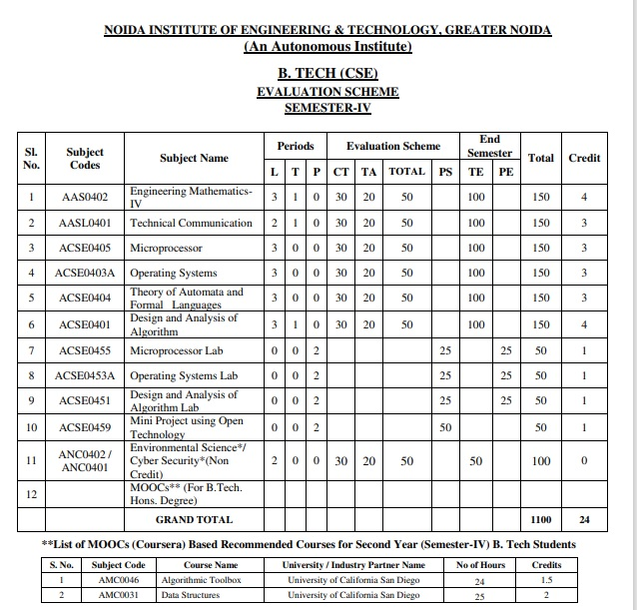
Evaluation Scheme

Slide 4
Syllabus
Unit-I (Statistical Techniques-I)
Introduction: Measures of central tendency: Mean, Median, Mode, Moment, Skewness, Kurtosis, Curve Fitting ,Method of least squares, Fitting of straight lines, Fitting of second degree parabola, Exponential curves ,Correlation and Rank correlation, Linear regression, nonlinear regression and multiple linear regression
Unit-II (Statistical Techniques-II)
Testing a Hypothesis, Null hypothesis, Alternative hypothesis, Level of significance, Confidence limits, p-value, Test of significance of difference of means, Z-test, t-test and Chi-square test, F-test, ANOVA: One way and Two way. Statistical Quality Control (SQC), Control Charts, Control Charts for variables (Mean and Range Charts), Control Charts for Variables ( p, np and C charts).

Slide 5
Syllabus
Unit III (Probability and Random Variable)
Random Variable: Definition of a Random Variable, Discrete Random Variable, Continuous Random Variable, Probability mass function, Probability Density Function, Distribution functions.
Multiple Random Variables: Joint density and distribution Function, Properties of Joint Distribution function, Marginal density Functions, Conditional Distribution and Density, Statistical Independence, Central Limit Theorem (Proof not expected).
Unit IV (Expectations and Probability Distribution)
Operation on One Random Variable – Expectations: Introduction, Expected Value of a Random Variable, Mean, Variance, Moment Generating Function, Binomial, Poisson, Normal, Exponential distribution.

Slide 6
Syllabus
Unit V (Wavelets and applications and Aptitude-IV)
Wavelet Transform, wavelet series. Basic wavelets (Haar/Shannon/Daubechies), orthogonal wavelets, multi-resolution analysis, reconstruction of wavelets and applications.
Number System, Permutation & Combination, Probability, Function, Data Interpretation, Syllogism.

Slide 7
Branch Wise Application
Data Analysis
Artificial intelligence
Network and Traffic modeling

Slide 8
Course Objectives
The objective of this course is to familiarize the students with statistical techniques. It aims to present the students with standard concepts and tools at an intermediate to superior level that will provide them well towards undertaking a variety of problems in the discipline.
The students will learn:
Understand the concept of correlation, moments, skewness and kurtosis and curve fitting.
Apply the concept of hypothesis testing and statistical quality control to create control charts.
Remember the concept of probability to evaluate probability distributions.
Understand the concept of Mathematical Expectations and Probability Distribution.
Remember the concept of Wavelet Transform and Solve the problems of Number System, Permutation & Combination, Probability, Function, Data Interpretation, Syllogism.

Slide 9
Course Outcomes
CO1: Understand the concept of correlation, moments, skewness and kurtosis and curve fitting.
CO2: Apply the concept of hypothesis testing and statistical quality control to create control charts.
CO3: Remember the concept of probability to evaluate probability distributions
CO4: Understand the concept of Mathematical Expectations and Probability Distribution
CO2: Remember the concept of Wavelet Transform and Solve the problems of Number System, Permutation & Combination, Probability, Function, Data Interpretation, Syllogism.

Slide 10
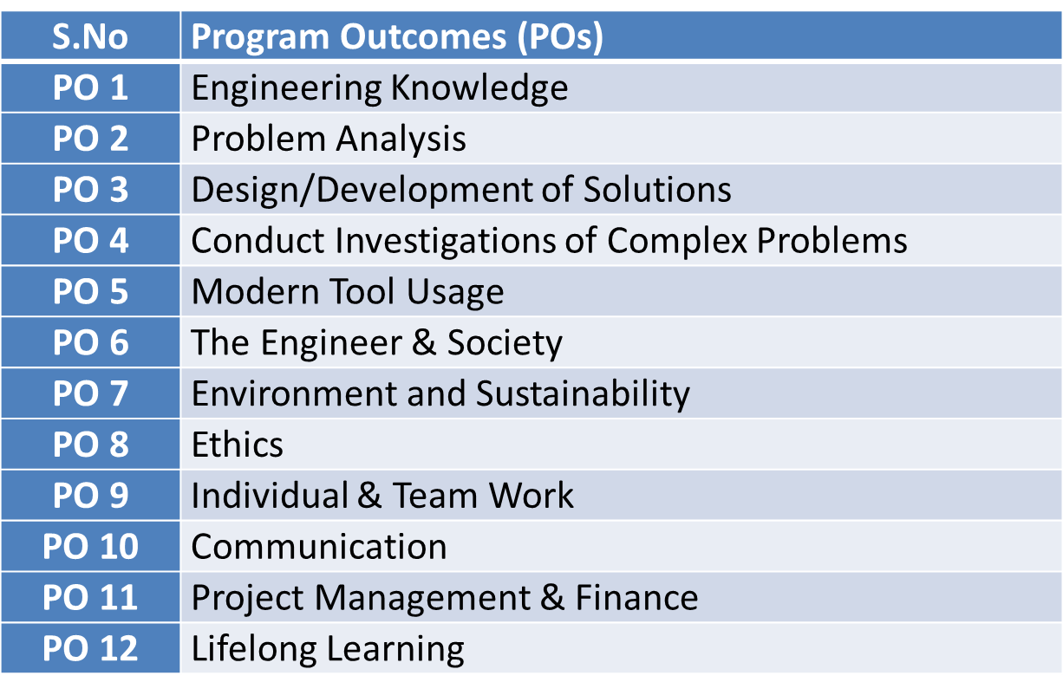
Program Outcomes

Slide 11
PSOs
PSO | Program Specific Outcomes(PSOs)
PSO1 | The ability to identify, analyze real world problems and design their ethical solutions using artificial intelligence, robotics, virtual/augmented reality, data analytics, block chain technology, and cloud computing
PSO2 | The ability to design and develop the hardware sensor devices and related interfacing software systems for solving complex engineering problems.
PSO3 | The ability to understand inter disciplinary computing techniques and to apply them in the design of advanced computing.
PSO4 | The ability to conduct investigation of complex problem with the help of technical, managerial, leadership qualities, and modern engineering tools provided by industry sponsored laboratories.

Slide 12
CO-PO Mapping(CO1)
Sr. No | Course Outcome | PO1 | PO2 | PO3 | PO4 | PO5 | PO6 | PO7 | PO8 | PO9 | PO10 | PO11 | PO12
1 | CO1 | H | H | H | H | L | L | L | L | L | L | L | M
2 | CO2 | H | H | H | H | L | L | L | L | L | L | M | M
3 | CO3 | H | H | H | H | L | L | L | L | L | L | M | M
4 | CO4 | H | H | H | H | L | L | L | L | L | L | L | M
5 | CO5 | H | H | H | H | L | L | L | L | L | L | M | M
*L= Low *M= Medium *H= High

Slide 13
CO-PSO Mapping(CO2)
CO | PSO1 | PSO2 | PSO3 | PSO4
CO.1 | H | L | M | L
CO.2 | L | M | L | M
CO.3 | M | M | M | M
CO.4 | H | M | M | M
CO.5 | H | M | M | M
*L= Low *M= Medium *H= High

Slide 14
Program Educational Objectives(PEOs)
PEO-1: To have an excellent scientific and engineering breadth so as to comprehend, analyze, design and provide sustainable solutions for real-life problems using state-of-the-art technologies.
PEO-2: To have a successful career in industries, to pursue higher studies or to support entrepreneurial endeavors and to face the global challenges.
PEO-3: To have an effective communication skills, professional attitude, ethical values and a desire to learn specific knowledge in emerging trends, technologies for research, innovation and product development and contribution to society.
PEO-4: To have life-long learning for up-skilling and re-skilling for successful professional career as engineer, scientist, entrepreneur and bureaucrat for betterment of society.

Slide 15
Result Analysis
Branch | Semester | Sections | No. of enrolled Students | No. Passed Students | % Passed
CS | IV | A | 67 | 65 | 97%
IOT | IV | A | 49 | 45 | 91.83%

Slide 16
End Semester Question Paper Template
Link:100 Marks Question Paper Template.docx

Slide 17
Prerequisite and Recap (CO1)
Knowledge of Maths 1 B.Tech.
Knowledge of Maths 2 B.Tech.
Knowledge of Permutation and Combination.

Slide 18
Brief Introduction about the Subject with Videos
We will discuss properties of complex function (limits, continuity, differentiability, Analyticity and integration)
In 3rd module we will discuss application of partial differential equations
In 4th module we will discuss numerical methods for solving algebraic equations, system of linear equations, definite integral and 1st order ordinary differential equation.
In 5th module we will discuss aptitude part.
https://youtu.be/iUhwCfz18os
https://youtu.be/ly4S0oi3Yz8
https://youtu.be/f8XzF9_2ijs

Slide 19
Unit Content
Introduction
Measures of central tendency: Mean, Median, Mode.
Moment
Skewness
Kurtosis
Curve Fitting
Method of least squares
Fitting of straight lines
Fitting of second degree parabola
Exponential curves
Correlation and Rank correlation,
Linear regression
Nonlinear regression
Multiple linear regression

Slide 20
Unit Objectives(CO1)
The objective of this course is to familiarize the engineers with concept of Statistical techniques.
It aims to show case the students with standard concepts and tools from B. Tech to deal with advanced level of mathematics and applications that would be essential for their disciplines.

Slide 21
Topic objectives (CO1)
Measures of central tendency
To present a brief picture of data- It helps in giving a brief description of the main feature of the entire data.
Essential for comparison- It helps in reducing the data to a single value which is used for doing comparative studies.
Helps in decision making- Most of the companies use measuring central tendency to plan and develop their businesses economy.
Formulation of policies- Many governments rely on this medium while forming any policies.

Slide 22
Measures of Central Tendency (CO1)
Measures of Central Tendency or Averages:
Definition : According to Prof. Bowley: Averages are “statistical constants which enable us to comprehend in a single effort the significance of the whole.”
Types of Measures of Central Tendency: There are five types of measures of central tendency
Arithmetic Mean or Simple Mean
Median
Mode
Geometric Mean
Harmonic Mean

Slide 23
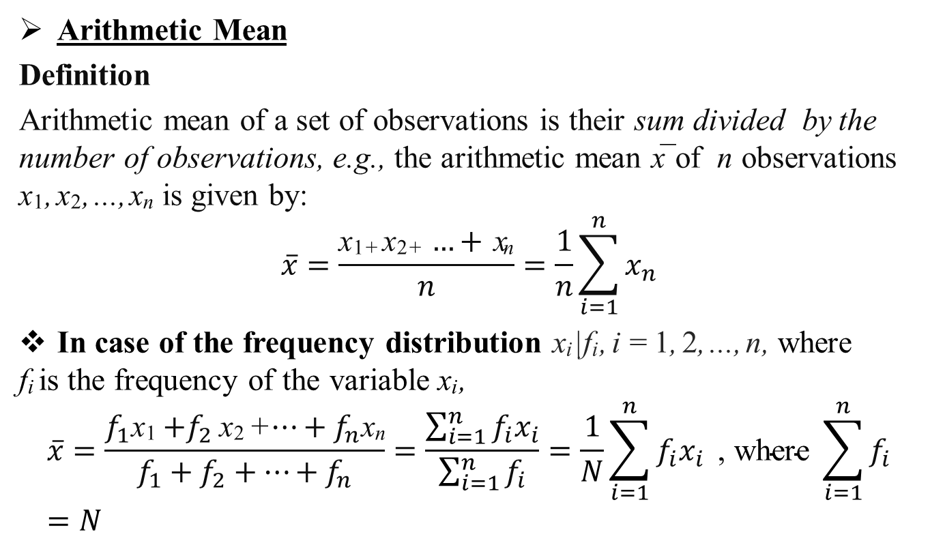
Arithmetic Mean (CO1)
Arithmetic Mean
Definition
Arithmetic mean of a set of observations is their sum divided by the number of observations, e.g., the arithmetic mean x¯ of n observations x₁, x₂, ..., x_{n} is given by:
$$\overline{x}=\frac{\text{x}\text{1}\text{+} \text{x}\text{2}\text{+} …+ \text{x}\text{n}}{n}=\frac{1}{n}\sum_{i=1}^{n}{x_{n}}$$
In case of the frequency distribution x_{i} |f_{i} , i = 1, 2, ..., n, where
f_{i} is the frequency of the variable x_{i} ,
$$\overline{x}=\frac{f_{1}\text{x}\text{1}{+f}_{2}\text{x}\text{2} \text{+}…+f_{n}\text{x}\text{n}}{f_{1}+f_{2}+…+f_{n}}=\frac{\sum_{i=1}^{n}{f_{i}x_{i}}}{\sum_{i=1}^{n}{f_{i}}}=\frac{1}{N}\sum_{i=1}^{n}{f_{i}x_{i}}\text{ , }\text{where} \sum_{i=1}^{n}{f_{i}}=N$$

Slide 24
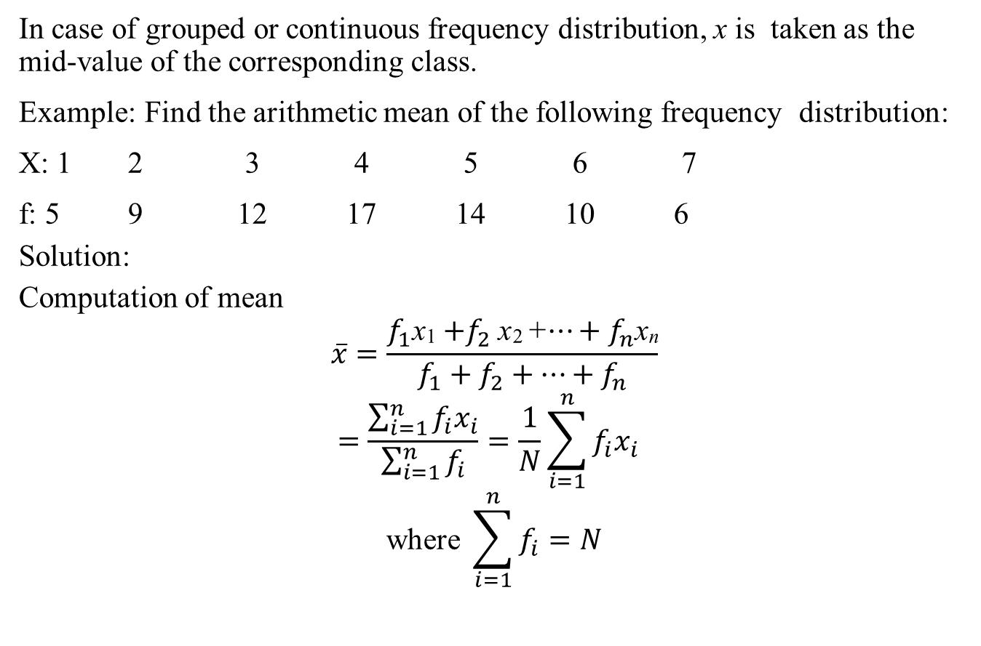
Arithmetic Mean(CO1)
In case of grouped or continuous frequency distribution, x is taken as the mid-value of the corresponding class.
Example: Find the arithmetic mean of the following frequency distribution:
X: 1 2 3 4 5 6 7
f: 5 9 12 17 14 10 6
Solution:
Computation of mean
$$\overline{x}=\frac{f_{1}\text{x}\text{1}{+f}_{2}\text{x}\text{2}\text{ +}…+f_{n}\text{x}\text{n}}{f_{1}+f_{2}+…+f_{n}}$$
$$=\frac{\sum_{i=1}^{n}{f_{i}x_{i}}}{\sum_{i=1}^{n}{f_{i}}}=\frac{1}{N}\sum_{i=1}^{n}{f_{i}x_{i}}$$
$$\text{where} \sum_{i=1}^{n}{f_{i}}=N$$

Slide 25
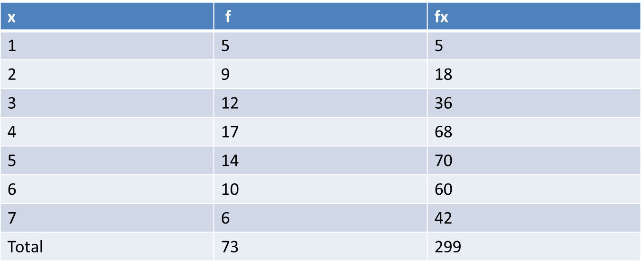
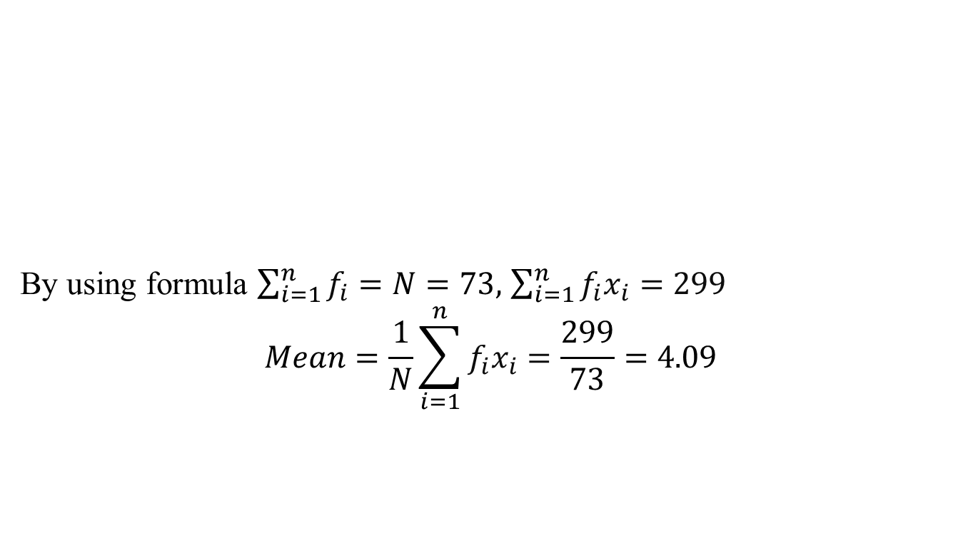
Arithmetic Mean(CO1)
By using formula $\sum_{i=1}^{n}{f_{i}}=N=73,$ $\sum_{i=1}^{n}{f_{i}x_{i}}=299$
$$Mean=\frac{1}{N}\sum_{i=1}^{n}{f_{i}x_{i}}=\frac{299}{73}=\text{4.09}$$

Slide 26
Daily Quiz (CO1)
Example: Calculate the mean for the following frequency distribution:
Solution: Arithmetic mean =25.404
Example: The average salary of male employees in a farm was Rs. 5,200 and that of females was Rs. 4,200. The mean salary of all the employees was Rs. 5,000.Find the percentage of male and female employees.
Class interval | 0-8 | 8-16 | 16-24 | 24-32 | 32-40 | 40-48
Frequency | 8 | 7 | 16 | 24 | 15 | 7

Slide 27
Median(CO1)
Median:
Definition: Median of a distribution is the value of the variable which divides it into two equal parts.
It is the value such that the number of observations above it is equal to the number of observations below it. The median is thus a positional average.
Ungrouped Data:
If the number of observations is odd then median is the middle value after the values have been arranged in ascending or descending order of magnitude.
In case of even number of observations, there are two middle terms and median is obtained by taking the arithmetic mean of middle terms.

Slide 28
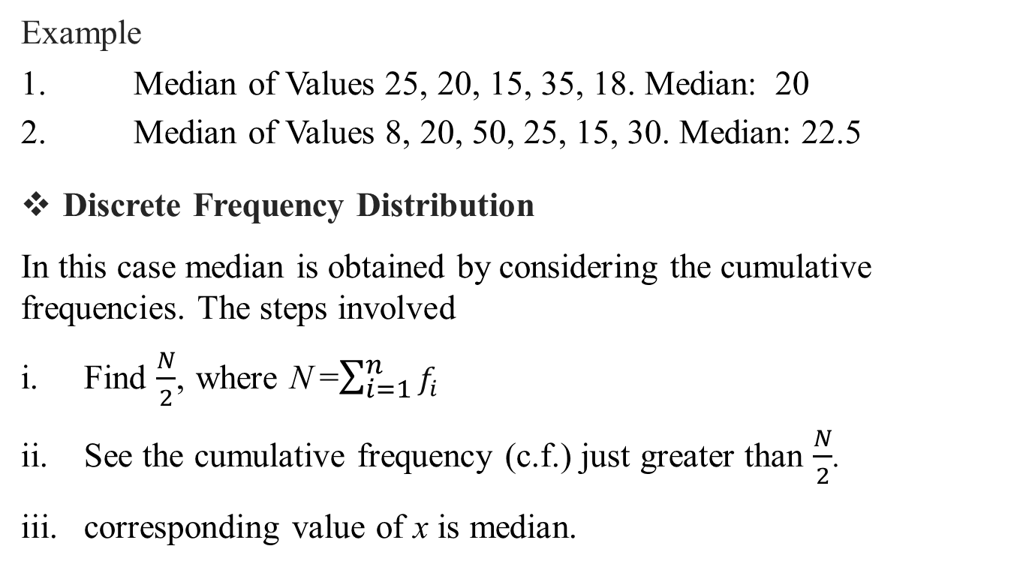
Median(CO1)
Example
1. Median of Values 25, 20, 15, 35, 18. Median: 20
2. Median of Values 8, 20, 50, 25, 15, 30. Median: 22.5
Discrete Frequency Distribution
In this case median is obtained by considering the cumulative frequencies. The steps involved
Find $\frac{N}{2}$, where N =$\sum_{i=1}^{n}{f_{i}}$
See the cumulative frequency (c.f.) just greater than $\frac{N}{2}$.
corresponding value of x is median.

Slide 29
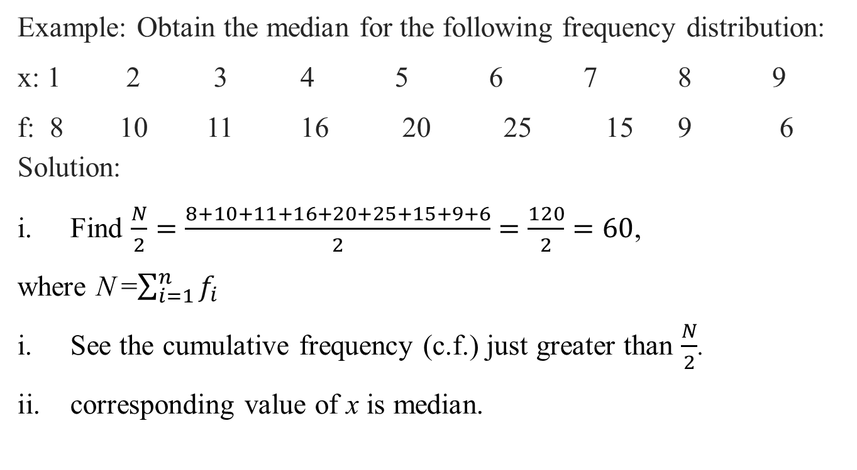
Median(CO1)
Example: Obtain the median for the following frequency distribution:
x: 1 2 3 4 5 6 7 8 9
f: 8 10 11 16 20 25 15 9 6
Solution:
Find $\frac{N}{2}=\frac{8+10+11+16+20+25+15+9+6}{2}=\frac{120}{2}=60$,
where N =$\sum_{i=1}^{n}{f_{i}}$
See the cumulative frequency (c.f.) just greater than $\frac{N}{2}$.
corresponding value of x is median.

Slide 30
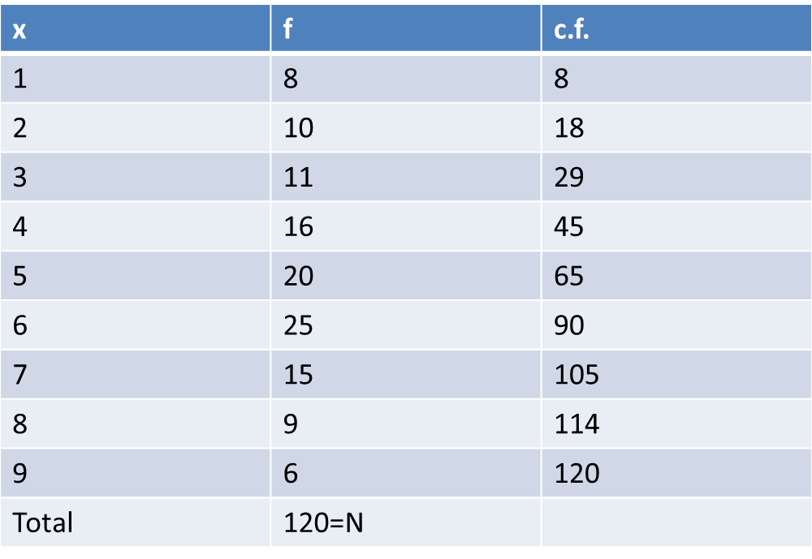
Median(CO1)
Here N = 120, The cumulative frequency just greater than $\frac{N}{2}$ is 65 and the 2 value of x corresponding to 65 is 5. Therefore, median is 5.

Slide 31
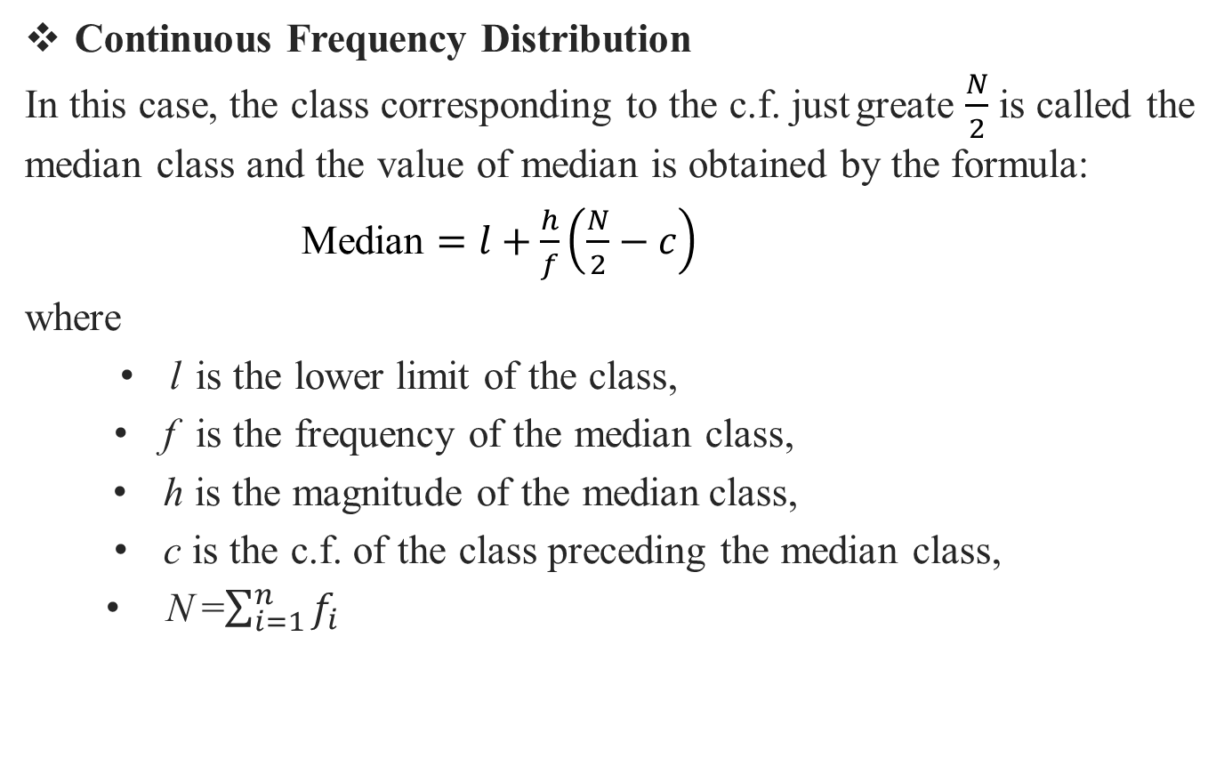
Median(CO1)
Continuous Frequency Distribution
In this case, the class corresponding to the c.f. just greate $\frac{N}{2}$is called the median class and the value of median is obtained by the formula:
Median $=l+\frac{h}{f}\left(\frac{N}{2}−c\right)$
where
l is the lower limit of the class,
f is the frequency of the median class,
h is the magnitude of the median class,
c is the c.f. of the class preceding the median class,
N =$\sum_{i=1}^{n}{f_{i}}$

Slide 32
Daily Quiz(CO1)
Example : find the median wages of the following distribution.
Solution: The median wage is Rs. 4,675.
Wages | No. of workers
2000-3000 | 3
3000-4000 | 5
4000-5000 | 20
5000-6000 | 10
6000-7000 | 5

Slide 33
Mode(CO1)
Mode:
Mode is the value which occurs most frequently in a set of observations and around which the other items of the set cluster
densely.
It is the point of maximum frequency or the point of greatest density.
In other words the mode or modal value of the distribution is that value of the variate for which frequency is maximum.
Calculation of Mode
In case of discrete distribution: Mode is the value of x corresponding to maximum frequency but in any one (or more)of the following cases.

Slide 34
Mode(CO1)
If the maximum frequency is repeated.
If the maximum frequency occurs in the very beginning or at the end of distribution .
If there are irregularities in the distribution, the value of mode is determined by the method of grouping.
In case of continuous frequency distribution: mode is given by the formula
Mode$=l+\frac{f_{m}−f_{1}}{2f_{m}−f_{1}−f_{2}}×h$
where $l$ is the lower limit,$h the$width and $f_{m}$ the frequency of the model class $f_{1}and f_{2}$ are the frequencies of the classes preceding and succeeding the modal class respectively. While applying the above formula it is necessary to see that the class intervals are of the same size.

Slide 35
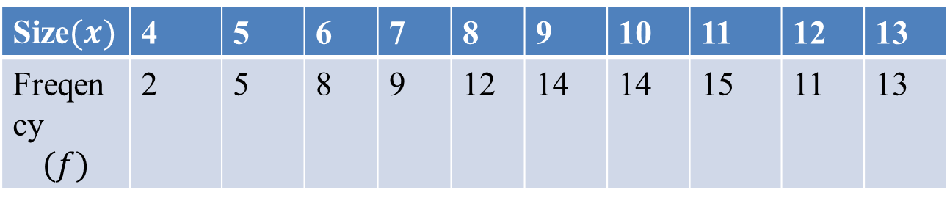
Mode(CO1)
For a symmetrical distribution, mean, median and mode coincide.
When mode is ill defined ,where the method of grouping also fails
its value can be ascertained by the formula
Mode=3Median-2Mean
This measure is called the empirical mode.
Q. Calculate the mode from the following frequency distribution.
Solution: Method of Grouping :
Size$(x)$ | 4 | 5 | 6 | 7 | 8 | 9 | 10 | 11 | 12 | 13
Freqency $$(f)$$ | 2 | 5 | 8 | 9 | 12 | 14 | 14 | 15 | 11 | 13

Slide 36
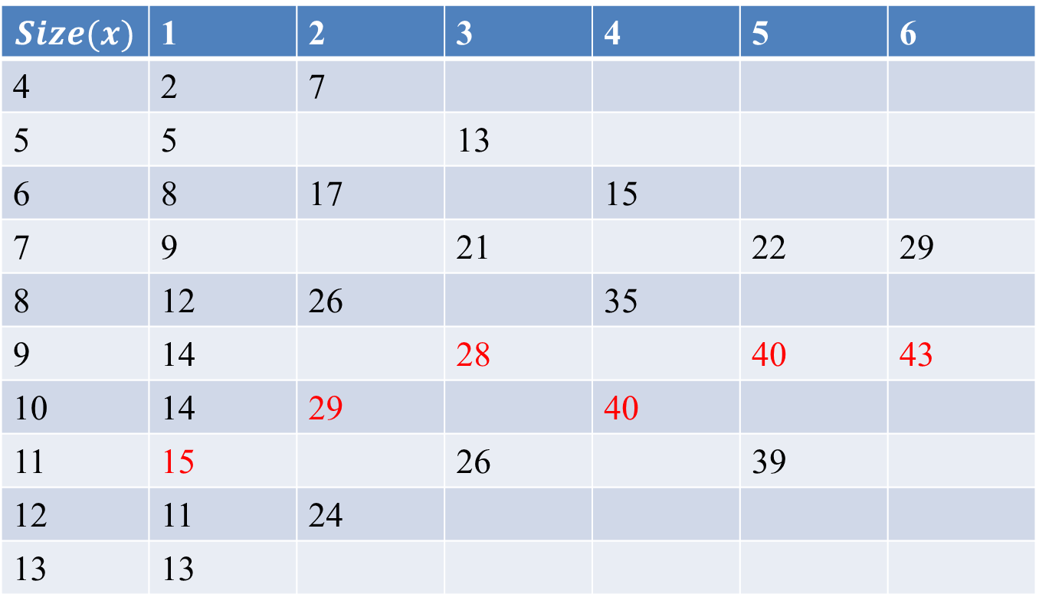
Mode(CO1)
$$Size(x)$$ | 1 | 2 | 3 | 4 | 5 | 6
4 | 2 | 7
5 | 5 |  | 13
6 | 8 | 17 |  | 15
7 | 9 |  | 21 |  | 22 | 29
8 | 12 | 26 |  | 35
9 | 14 |  | 28 |  | 40 | 43
10 | 14 | 29 |  | 40
11 | 15 |  | 26 |  | 39
12 | 11 | 24
13 | 13

Slide 37
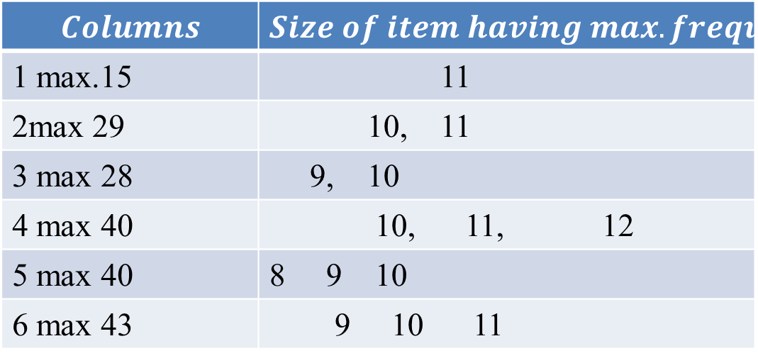
Mode(CO1)
Since the item 10 occurs maximum number of times i.e.5times,hence the mode is 10.
$$Columns$$ | $$Size of item having max.frequency$$
1 max.15 | 11
2max 29 | 10, 11
3 max 28 | 9, 10
4 max 40 | 10, 11, 12
5 max 40 | 8 9 10
6 max 43 | 9 10 11

Slide 38
Mode(CO1)
Q. Find the mode of the following:
Solution: Here the greatest frequency 32 lies in the class 16-20.Hence modal class is 16-20.But the actual limits of this class are 15.5-20.5.
$$l=15.5,f_{m}=32,f_{1}=16,f_{2}=24,h=5$$
Marks | 0-5 | 6-10 | 11-15 | 16-20 | 21-25
No.of candidates | 7 | 10 | 16 | 32 | 24
Marks | 26-30 | 31-35 | 36-40 | 41-45
No.of candidates | 18 | 10 | 5 | 1

Slide 39
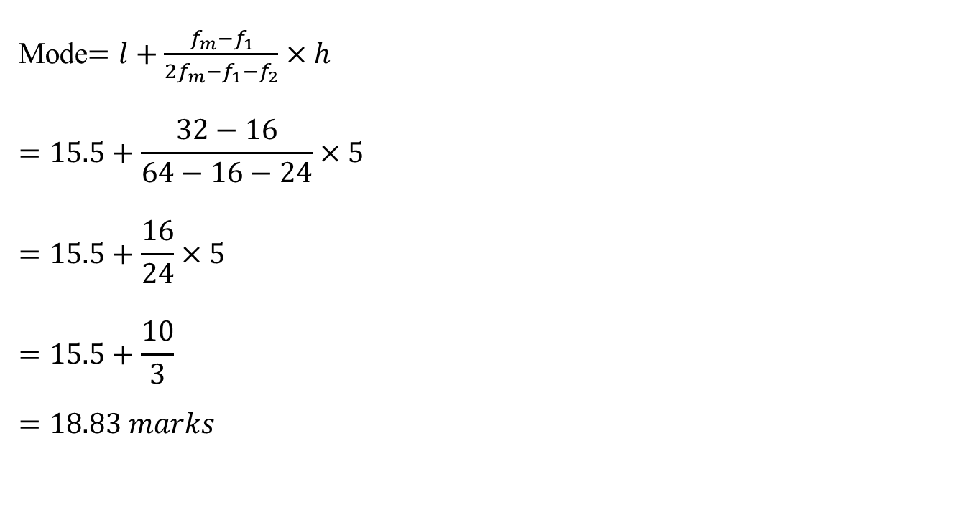
Mode(CO1)
Mode$=l+\frac{f_{m}−f_{1}}{2f_{m}−f_{1}−f_{2}}×h$
$$=15.5+\frac{32−16}{64−16−24}×5$$
$$=15.5+\frac{16}{24}×5$$
$$=15.5+\frac{10}{3}$$
$$=18.83 marks$$

Slide 40
Daily Quiz(CO1)
Q.1 Calculate the mean, median and mode of the following data-
Wages (in Rs) | 0-20 | 20-40 | 40-60 | 60-80 | 80-100 | 100-120 | 120-140
No. of Workers | 6 | 8 | 10 | 12 | 6 | 5 | 3

Slide 41
Recap(CO1)
Measures of central tendency
Mean
Mode
Median

Slide 42
Topic Objective (CO1)
Moments
In mathematical statistics it involve a basic calculation. These calculations can be used to find a probability distribution's mean, variance, and skewness.

Slide 43
Moments (CO1)
Moments: The moment of a distribution are the arithmetic means of the various powers of the deviations of items from some given number.
Moments about mean (central moment)
Moments about any arbitrary number (Raw Moment)
Moments about origin

Slide 44

Central Moments (CO1)
Moment about mean (central moment):
For an Individual Series :If $x_{1},x_{2,…..}x_{n}$ are the values of the variable under consideration , the $r^{th}$ moment $μ_{r}$ about mean $\overline{ x}$ is defined as
For a frequency Distribution: If $x_{1,}x_{2,….,}x_{n}$ are the values of a variable $x$ with the corresponding frequencies $f_{1},f_{2},….,f_{n}$ respectively then $r^{th}$ moment $μ_{r}$ about the mean $\overline{x}$ is defined as
Moment about mean $μ_{r}=\frac{\sum_{i=1}^{n}{{\left(x_{i}−\overline{x}\right)}^{r}}}{n};r=0,1,2,….$

Slide 45
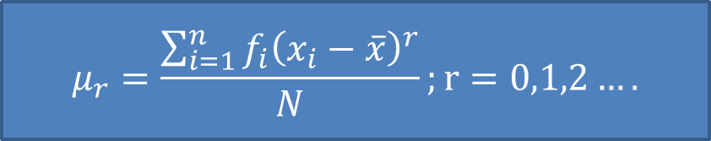
Central Moments (CO1)
where $N=\sum_{i=1}^{n}{f_{i}}$
in particular $μ_{0}=\frac{1}{N}\sum_{i=1}^{n}{{f_{i}\left(x_{i}−\overline{x}\right)}^{0}=\frac{1}{N}\sum_{i=1}^{n}{f_{i}}=\frac{N}{N}=1}$
Note. In case of a frequency distribution with class intervals, the values of $x$are the midpoints of the intervals.
Example 1.Find the first four moments for the following individual series.
Solution: Calculation of Moments
$$μ_{r}=\frac{\sum_{i=1}^{n}{{f_{i}\left(x_{i}−\overline{x}\right)}^{r}}}{N};r=0,1,2….$$
$$x$$ | 3 | 6 | 8 | 10 | 18

Slide 46
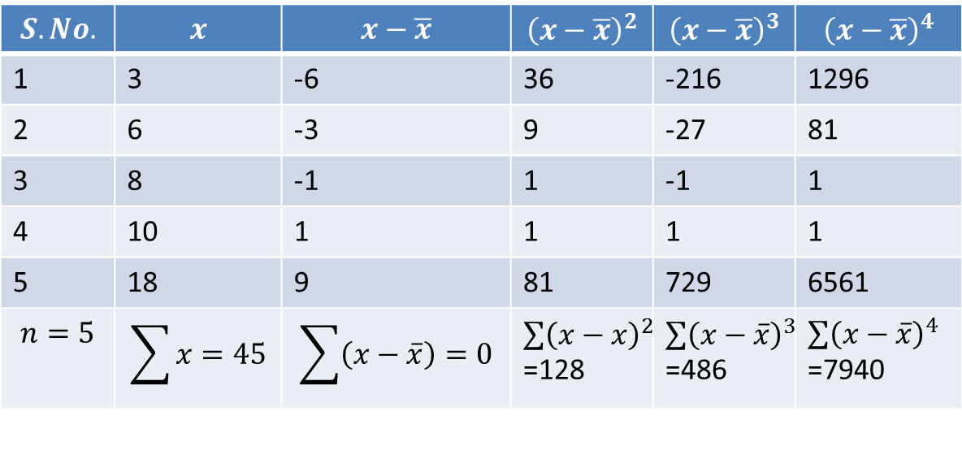
Central Moments (CO1)

Slide 47
Central Moments (CO1)
For any distribution,$μ_{0}=1$
$$μ_{1}=\frac{1}{n}\sum_{i=1}^{n}{\left(x_{i}−\overline{x}\right)=0}$$
For any distribution,$μ_{1}=0$, for r=2,
$$μ_{2}=\frac{1}{n}\sum_{i=1}^{n}{{\left(x_{i}−\overline{x}\right)}^{2}=\frac{128}{5}=25.6}$$
Therefore for any distribution ,$μ_{2}$ coincides with the variance of the distribution.
Similarly, $μ_{3}=\frac{1}{n}\sum_{i=1}^{n}{{\left(x_{i}−\overline{x}\right)}^{3}=\frac{486}{5}=97.2}$
$μ_{4}=\frac{1}{n}\sum_{i=1}^{n}{{\left(x_{i}−\overline{x}\right)}^{4}=\frac{7940}{5}=1588}$

Slide 48
Central Moments (CO1)
Now $\overline{x}=\frac{\sum{x}}{n}$=$\frac{45}{5}$=9
$μ_{1}=\frac{\sum{\left(x−\overline{x}\right)}}{n}$=$\frac{0}{5}$=$0$,
$μ_{2}=\frac{\sum{{\left(x−\overline{x}\right)}^{2}}}{n}$=$\frac{128}{5}$=$25.6$,
$μ_{3}=\frac{\sum{{\left(x−\overline{x}\right)}^{3}}}{n}$=$\frac{486}{5}$=$97.$2,
$μ_{4}=\frac{\sum{{\left(x−\overline{x}\right)}^{4}}}{n}$=$\frac{7940}{5}$=$1588$,

Slide 49
Central Moments (CO1)
For any distribution,$μ_{0}=1$ for r=1
$$μ_{1}=\frac{1}{N}\sum_{i=1}^{n}{f_{i}\left(x_{i}−\overline{x}\right)=\frac{1}{N}\sum_{i=1}^{n}{f_{i}x_{i}}−\overline{x}\left[\frac{1}{N}\sum_{i=1}^{n}{f_{i}}\right]=\overline{x}−\overline{x}=0}$$
For any distribution,$μ_{1}=0$, for r=2,
$$μ_{2}=\frac{1}{N}\sum_{i=1}^{n}{f_{i}{\left(x_{i}−\overline{x}\right)}^{2}={\left(S.D\right)}^{2}=Variance}$$
Therefore for any distribution ,$μ_{2}$ coincides with the variance of the distribution.
Similarly, $μ_{3}=\frac{1}{N}\sum_{i=1}^{n}{f_{i}{\left(x_{i}−\overline{x}\right)}^{3}}$
$μ_{4}=\frac{1}{N}\sum_{i=1}^{n}{f_{i}{\left(x_{i}−\overline{x}\right)}^{4}}$ and so on.

Slide 50
Central Moments (CO1)
Example $μ_{1,}μ_{2,}μ_{3,}μ_{4 }$for the following frequency distribution.
Sol. Calculation of Moments
Marks | 5-15 | 15-25 | 25-35 | 35-45 | 45-55 | 55-65
No.of students | 10 | 20 | 25 | 20 | 15 | 10

Slide 51
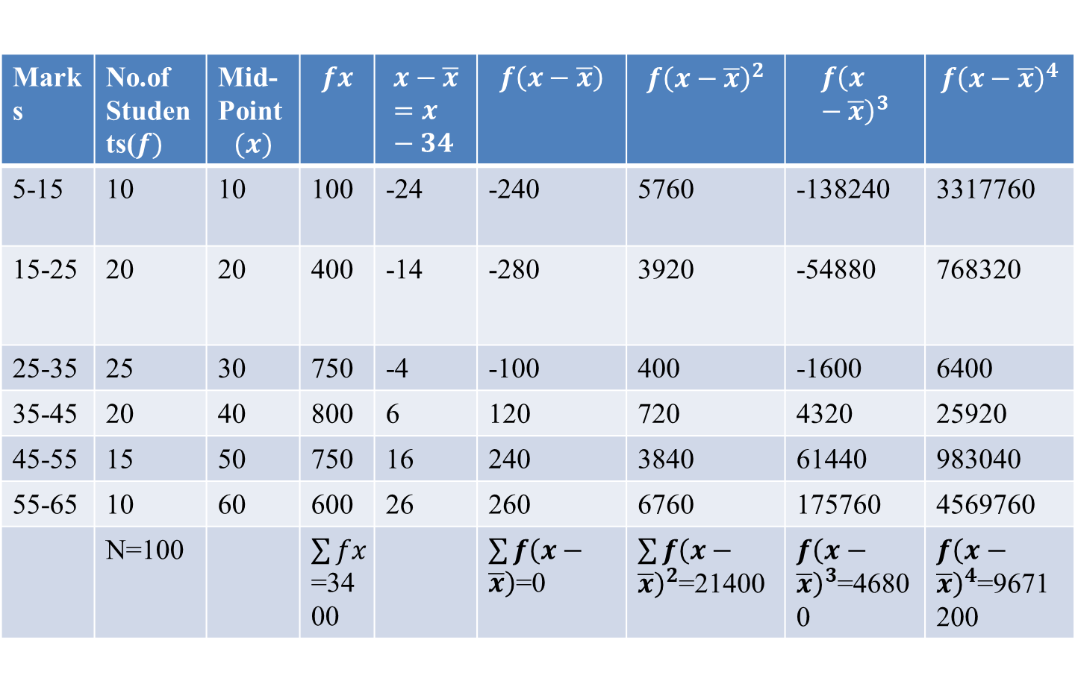
Central Moments (CO1)
Marks | No.of Students($f)$ | Mid-Point $$(x)$$ | $$fx$$ | $$x−\overline{x}=x−34$$ | $$f\left(x−\overline{x}\right)$$ | $$f{\left(x−\overline{x}\right)}^{2}$$ | $$f{\left(x−\overline{x}\right)}^{3}$$ | $$f{\left(x−\overline{x}\right)}^{4}$$
5-15 | 10 | 10 | 100 | -24 | -240 | 5760 | -138240 | 3317760
15-25 | 20 | 20 | 400 | -14 | -280 | 3920 | -54880 | 768320
25-35 | 25 | 30 | 750 | -4 | -100 | 400 | -1600 | 6400
35-45 | 20 | 40 | 800 | 6 | 120 | 720 | 4320 | 25920
45-55 | 15 | 50 | 750 | 16 | 240 | 3840 | 61440 | 983040
55-65 | 10 | 60 | 600 | 26 | 260 | 6760 | 175760 | 4569760
 | N=100 |  | $\sum{fx}$=3400 |  | $\sum{f\left(x−\overline{x}\right)}$=0 | $\sum{f{\left(x−\overline{x}\right)}^{2}}$=21400 | $f{\left(x−\overline{x}\right)}^{3}$=46800 | $f{\left(x−\overline{x}\right)}^{4}$=9671200

Slide 52
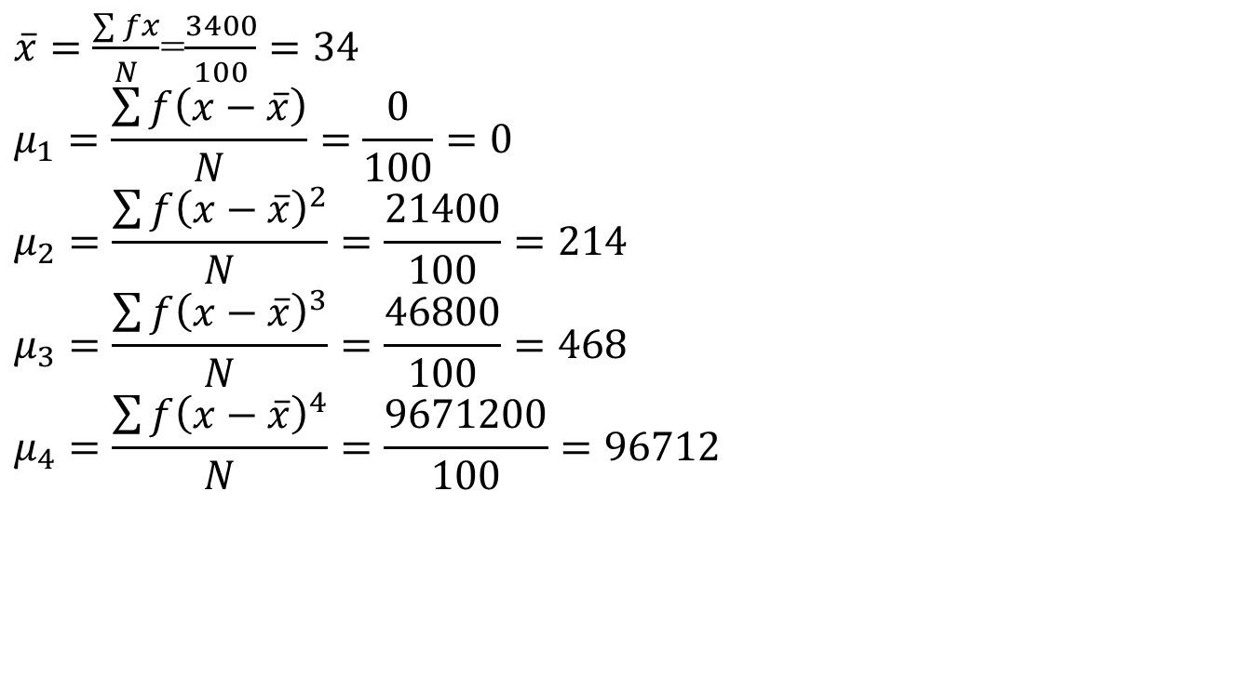
Central Moments (CO1)
$\overline{x}=\frac{\sum{fx}}{N}$=$\frac{3400}{100}=34$
$$μ_{1}=\frac{\sum{f\left(x−\overline{x}\right)}}{N}=\frac{0}{100}=0$$
$$μ_{2}=\frac{\sum{f{\left(x−\overline{x}\right)}^{2}}}{N}=\frac{21400}{100}=214$$
$$μ_{3}=\frac{\sum{f{\left(x−\overline{x}\right)}^{3}}}{N}=\frac{46800}{100}=468$$
$$μ_{4}=\frac{\sum{f{\left(x−\overline{x}\right)}^{4}}}{N}=\frac{9671200}{100}=96712$$

Slide 53
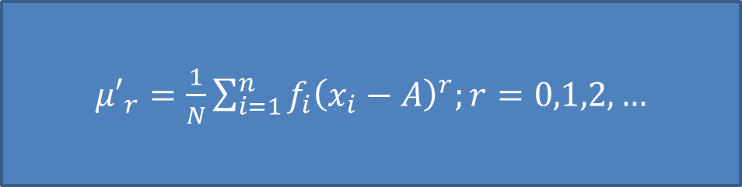
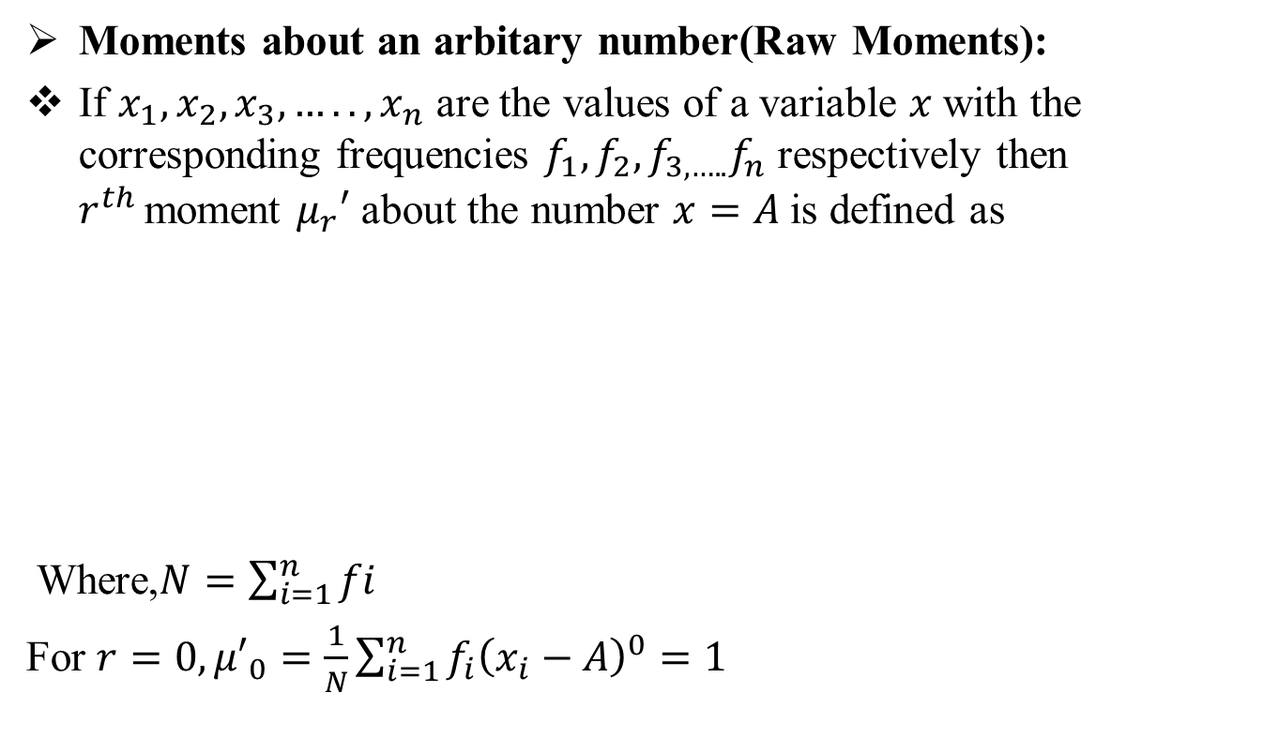
Raw Moments (CO1)
Moments about an arbitary number(Raw Moments):
If $x_{1},x_{2},x_{3},…..,x_{n}$ are the values of a variable $x$with the corresponding frequencies $f_{1},f_{2},f_{3,…..}f_{n}$ respectively then $r^{th }$moment $μ_{r}′$ about the number $x=A$is defined as
Where,$N=\sum_{i=1}^{n}{fi}$
For $r=0, {μ′}_{0}=\frac{1}{N}\sum_{i=1}^{n}{f_{i}{\left(x_{i}−A\right)}^{0}}=1$
${μ′}_{r}=\frac{1}{N}\sum_{i=1}^{n}{f_{i}{\left(x_{i}−A\right)}^{r};r=0,1,2,…}$

Slide 54
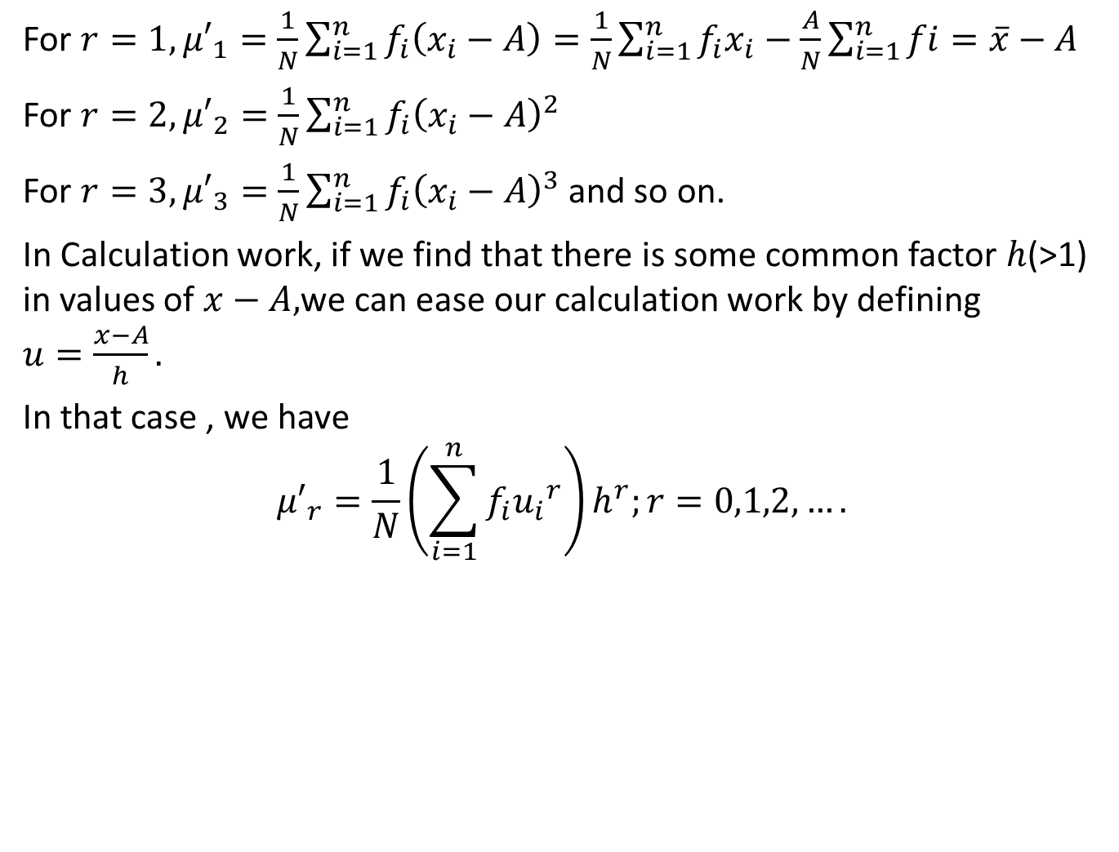
Raw Moments (CO1)
For $r=1, {μ′}_{1}=\frac{1}{N}\sum_{i=1}^{n}{f_{i}\left(x_{i}−A\right)}=\frac{1}{N}\sum_{i=1}^{n}{f_{i}x_{i}}−\frac{A}{N}\sum_{i=1}^{n}{fi}=\overline{x}−A$
For $r=2, {μ′}_{2}=\frac{1}{N}\sum_{i=1}^{n}{f_{i}{\left(x_{i}−A\right)}^{2}}$
For $r=3, {μ′}_{3}=\frac{1}{N}\sum_{i=1}^{n}{f_{i}{\left(x_{i}−A\right)}^{3}}$and so on.
In Calculation work, if we find that there is some common factor $h$(>1) in values of $x−A,$we can ease our calculation work by defining $u=\frac{x−A}{h}.$
In that case , we have
$${μ′}_{r}=\frac{1}{N}\left(\sum_{i=1}^{n}{f_{i}{u_{i}}^{r}}\right)h^{r};r=0,1,2,….$$

Slide 55

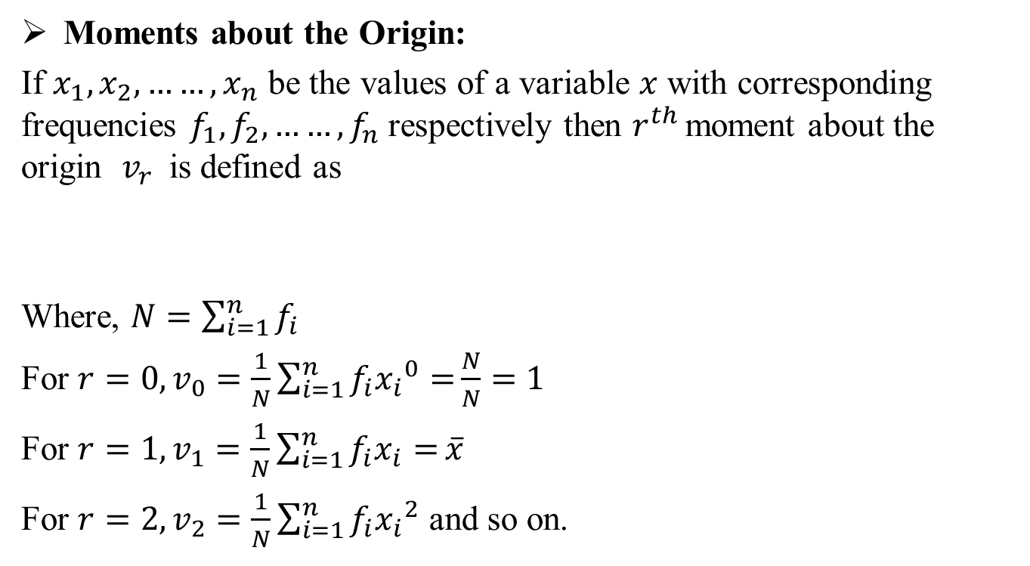
Moments about the origin (CO1)
Moments about the Origin:
If $x_{1},x_{2},……,x_{n}$ be the values of a variable $x$ with corresponding frequencies $f_{1},f_{2},……,f_{n}$respectively then $r^{th }$moment about the origin $v_{r}$is defined as
Where, $N=\sum_{i=1}^{n}{f_{i}}$
For $r=0, v_{0}=\frac{1}{N}\sum_{i=1}^{n}{f_{i}{x_{i}}^{0}=}\frac{N}{N}=1$
For $r=1, v_{1}=\frac{1}{N}\sum_{i=1}^{n}{f_{i}x_{i}=}\overline{x}$
For $r=2, v_{2}=\frac{1}{N}\sum_{i=1}^{n}{f_{i}{x_{i}}^{2}}$ and so on.
$v_{r}=\frac{1}{N}\sum_{i=1}^{n}{f_{i}{x_{i}}^{r}};r=0,1,2,….$

Slide 56
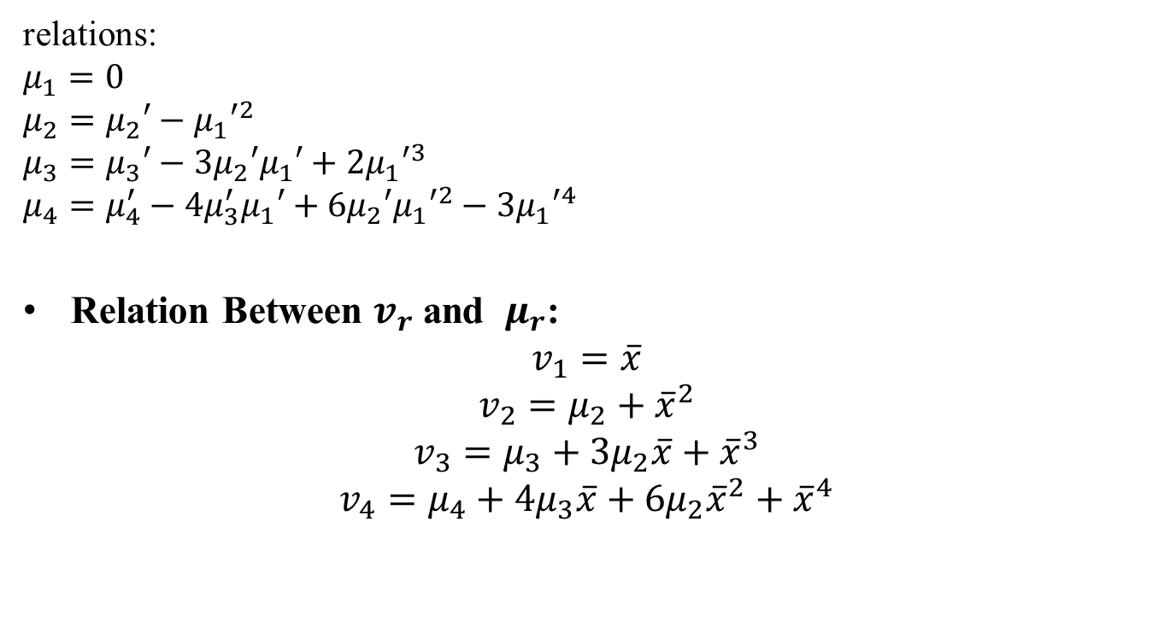
Relations (CO1)
relations:
$$μ_{1}=0$$
$$μ_{2}=μ_{2}′−{μ_{1}′}^{2}$$
$$μ_{3}=μ_{3}′−3μ_{2}′μ_{1}′+2{μ_{1}′}^{3}$$
$$μ_{4}=μ_{4}^{′}−4μ_{3}^{′}μ_{1}′+6μ_{2}′{μ_{1}′}^{2}−3{μ_{1}′}^{4}$$
Relation Between $v_{r}$ and $μ_{r}$:
$$v_{1}=\overline{x}$$
$$v_{2}=μ_{2}+{\overline{x}}^{2}$$
$$v_{3}=μ_{3}+3μ_{2}\overline{x}+{\overline{x}}^{3}$$
$$v_{4}=μ_{4}+4μ_{3}\overline{x}+6μ_{2}{\overline{x}}^{2}+{\overline{x}}^{4}$$

Slide 57
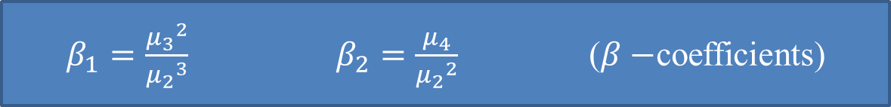
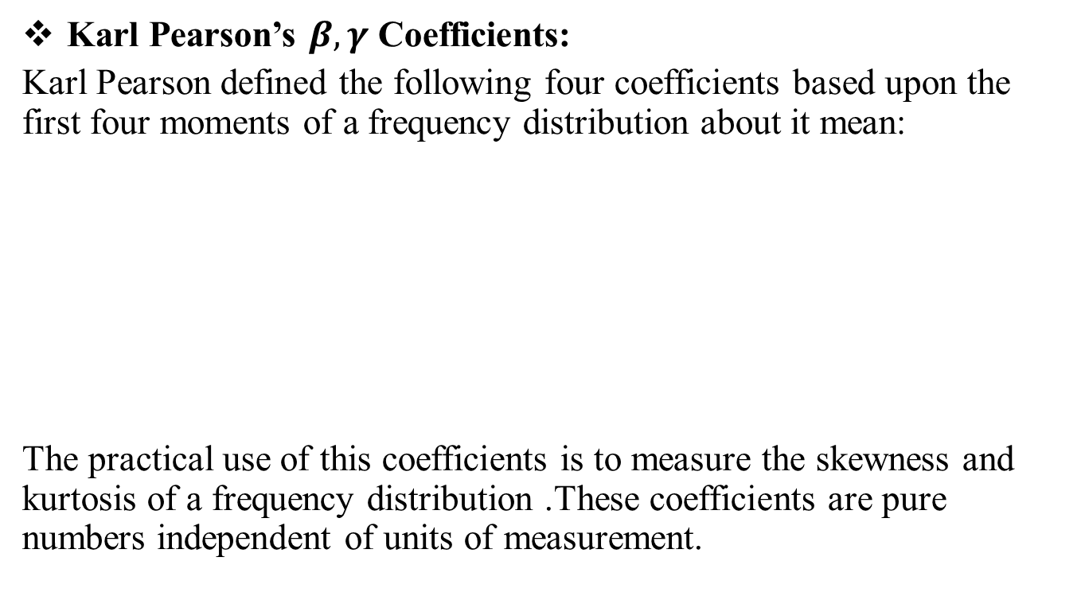
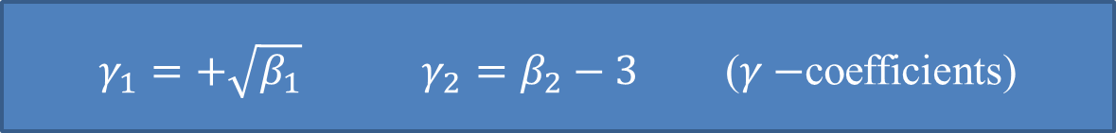
Karl Pearson’s Coefficients(CO1)
Karl Pearson’s $β,γ$ Coefficients:
Karl Pearson defined the following four coefficients based upon the first four moments of a frequency distribution about it mean:
The practical use of this coefficients is to measure the skewness and kurtosis of a frequency distribution .These coefficients are pure numbers independent of units of measurement.
$β_{1}=\frac{{μ_{3}}^{2}}{{μ_{2}}^{3}}$ $β_{2}=\frac{μ_{4}}{{μ_{2}}^{2}}$ ($β−$coefficients)
$γ_{1}=+\sqrt{β_{1}}$ $γ_{2}=β_{2}−3$ ($γ−$coefficients)

Slide 58
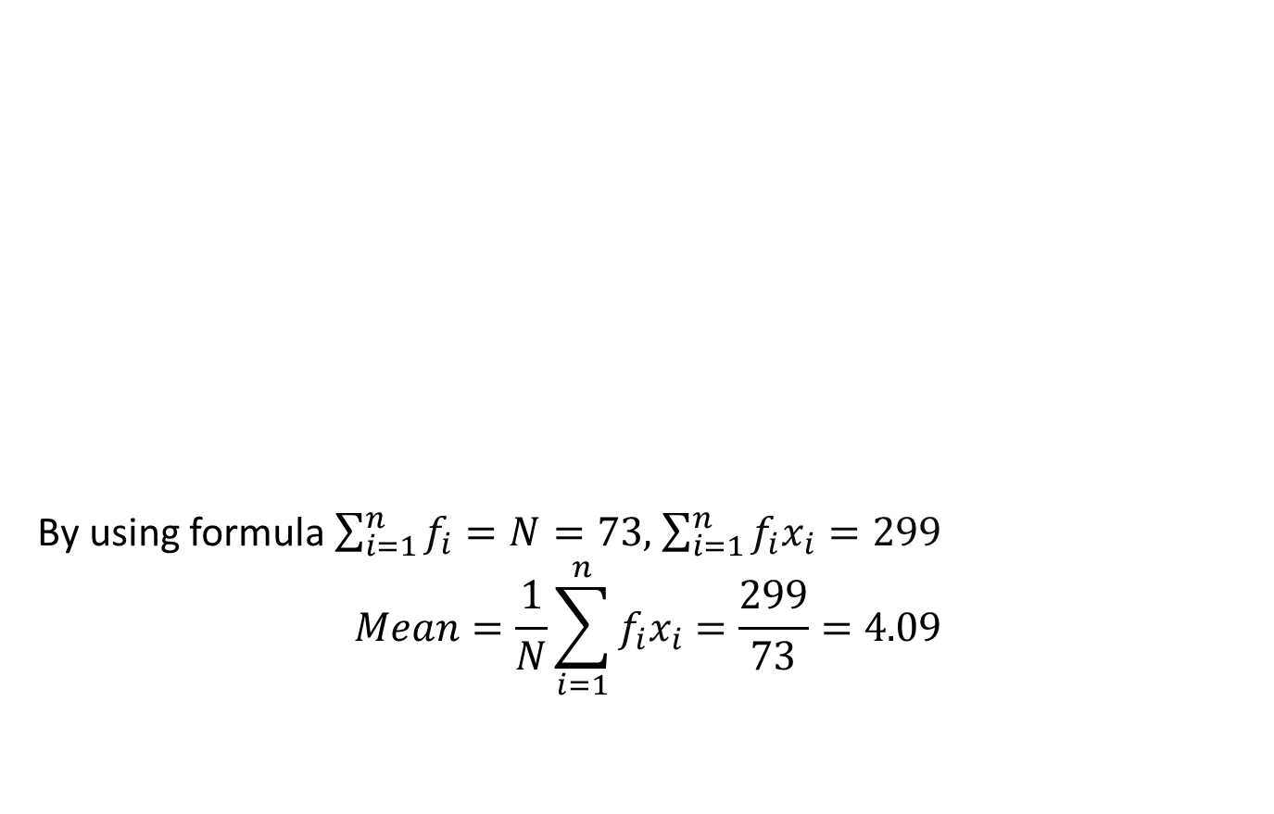
Karl Pearson’s Coefficients(CO1)
Example1 : The first three moments of a distribution about the value “2” of the variable are 1,16 and $−$40.Show that the mean is 3,variance is 15 and $μ_{3}=−86.$
Solution: We have A=2,${μ′}_{1}=1$, ${μ′}_{2}=16$ and ${μ′}_{3}=−40$
We have that ${μ′}_{1}=\overline{x}−A⟹\overline{x}={μ′}_{1}+A=1+2=3$
Variance=$μ_{2}={μ′}_{2}−{{μ′}_{1}}^{2}=16−{\left(1\right)}^{2}=15$
$$μ_{3}={μ′}_{3}−3{μ^{′}}_{2}{μ^{′}}_{1}+2{{μ^{′}}_{1}}^{3}=−40−3\left(16\right)\left(1\right)+2{\left(1\right)}^{3}=−40−48+2=−86.$$

Slide 59
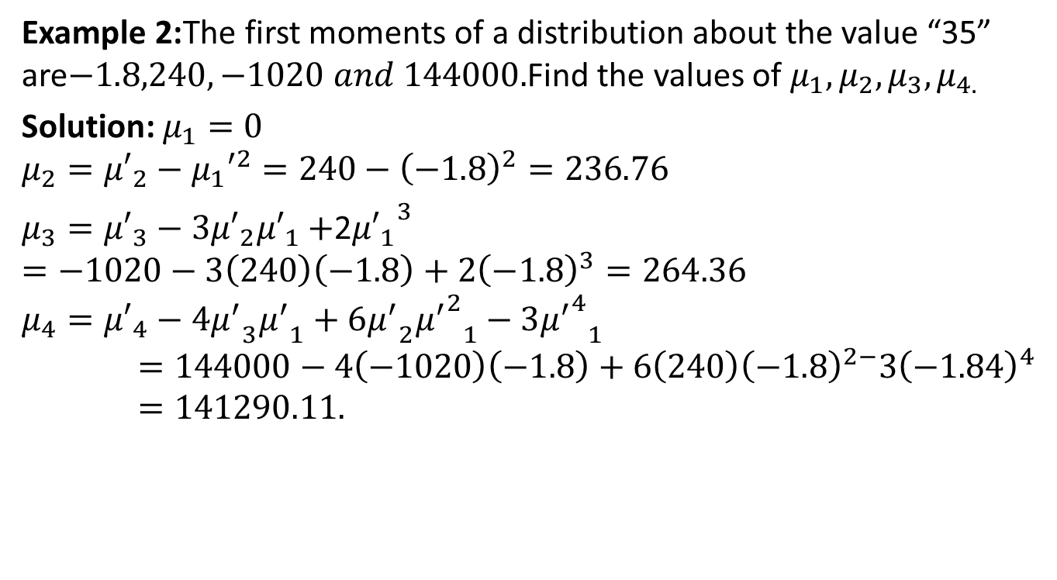
Karl Pearson’s Coefficients(CO1)
Example 2:The first moments of a distribution about the value “35” are$−1.8,240,−1020 and 144000.$Find the values of $μ_{1},μ_{2},μ_{3},μ_{4.}$
Solution: $μ_{1}=0$
$$μ_{2}={μ′}_{2}−{μ_{1}′}^{2}=240−{\left(−1.8\right)}^{2}=236.76$$
$μ_{3}={μ′}_{3}−3{μ′}_{2}{μ′}_{1}+$2${{μ′}_{1}}^{3}$
$$=−1020−3\left(240\right)\left(−1.8\right)+2{\left(−1.8\right)}^{3}=264.36$$
$$μ_{4}={μ′}_{4}−4{μ^{′}}_{3}{μ^{′}}_{1}+6{μ^{′}}_{2}{{μ^{′}}^{2}}_{1}−3{{μ^{′}}^{4}}_{1}=144000−4\left(−1020\right)\left(−1.8\right)+6\left(240\right){\left(−1.8\right)}^{2−}3{\left(−1.84\right)}^{4}=141290.11.$$

Slide 60
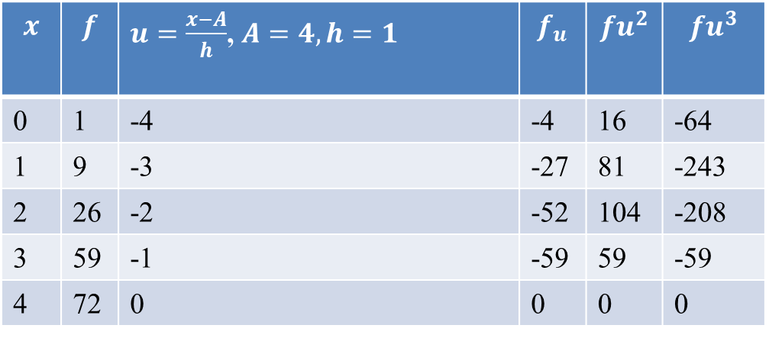
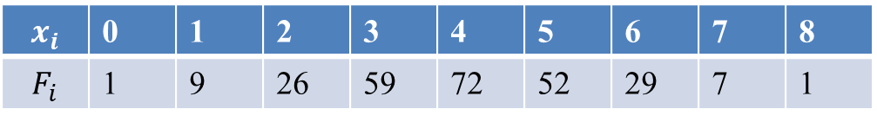
Karl Pearson’s Coefficients(CO1)
Example 3:Calculate the variance and third central moment from the following data.
Solution: Calculation of Moments
$$x_{i}$$ | 0 | 1 | 2 | 3 | 4 | 5 | 6 | 7 | 8
$$F_{i}$$ | 1 | 9 | 26 | 59 | 72 | 52 | 29 | 7 | 1
$$x$$ | $$f$$ | $u=\frac{x−A}{h}$, $A=4,h=1$ | $$f_{u}$$ | $${fu}^{2}$$ | $${fu}^{3}$$
0 | 1 | -4 | -4 | 16 | -64
1 | 9 | -3 | -27 | 81 | -243
2 | 26 | -2 | -52 | 104 | -208
3 | 59 | -1 | -59 | 59 | -59
4 | 72 | 0 | 0 | 0 | 0

Slide 61
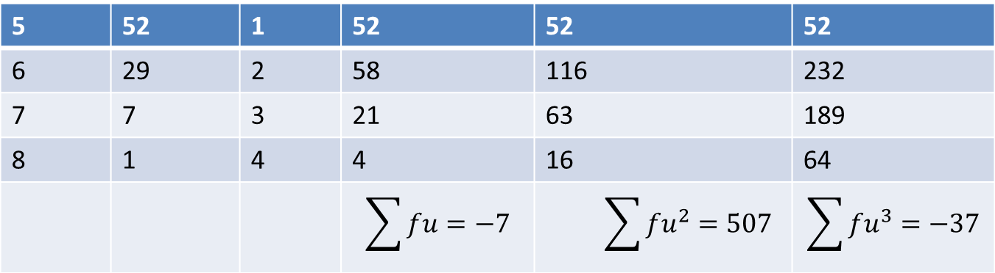
Karl Pearson’s Coefficients(CO1)
$${μ′}_{1}=\left(\frac{\sum{fu}}{N}\right)h=\frac{−7}{256}=−0.02734$$
${μ′}_{2}=\left(\frac{\sum{fu^{2}}}{N}\right)h^{2}=\frac{507}{256}=$1.9805

Slide 62
Karl Pearson’s Coefficients(CO1)
$${μ′}_{3}=\left(\frac{\sum{fu^{3}}}{N}\right)h^{3}=\frac{−37}{256}=−0.1445$$
Moments about Mean:
$$μ_{1}=0$$
$$μ_{2}={μ′}_{2}−{{μ^{′}}_{1}}^{2}=1.9805−{\left(−.02734\right)}^{2}=1.97975$$
Variance=1.97975
Also $μ_{3}={μ′}_{3}−3{μ′}_{2}{μ′}_{1}+2{μ_{1}′}^{3}$
$$=\left(−0.1445\right)−3\left(1.9805\right)\left(−0.02734\right)+2{\left(−0.02734\right)}^{3}$$
=0.0178997
Third central moment$=0.0178997.$

Slide 63
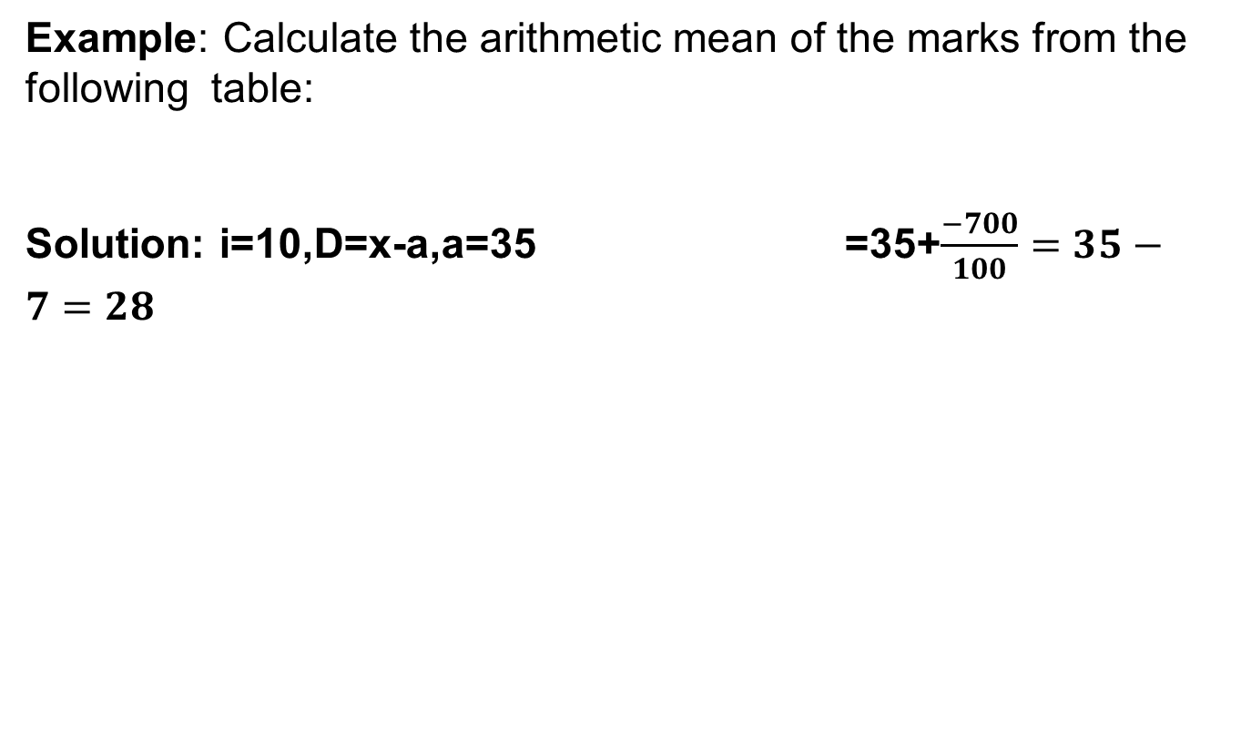
Daily Quiz(CO1)
Q1. The first four moments of a distribution are 3, 10.5,40.5,168.Comment upon the nature of the distribution.
Q2. For a distribution, the mean is 10,variance is 16,$γ_{1}$ is 1 and $β_{2}$ is 4. Find the first four moment about origin.

Slide 64
Recap(CO1)
Measures of central tendency
Moment

Slide 65
Topic objective (CO1)
Skewness
It tells us whether the distribution is normal or not
It gives us an idea about the nature and degree of concentration of observations about the mean
The empirical relation of mean, median and mode are based on a moderately skewed distribution

Slide 66
Skewness(CO1)
Skewness:
I t means lack of symmetry.
It gives us an idea about the shape of the curve which we can draw with the help of the given data.
A distribution is said to be skewed if—
Mean, median and mode fall at different points, i.e.,
Mean ƒ= Median ƒ= Mode;
Quartiles are not equidistant from median; and
The curve drawn with the help of the given data is not symmetrical but stretched more to one side than to the other.

Slide 67
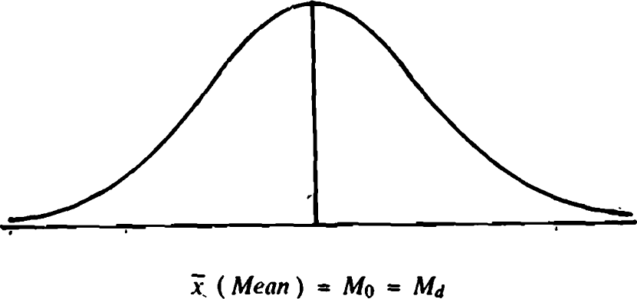
Skewness(CO1)
Symmetrical Distribution
A symmetric distribution is a type of distribution where the left side of the distribution mirrors the right side. In a symmetric distribution, the mean, mode and median all fall at the same point.

Slide 68
Skewness(CO1)
Measures of Skewness:
The measures of skewness are:
S_{k} = M − M_{d} ,
S_{k} = M − M_{o} ,
S_{k} = (Q₃ − M_{d} ) − (M_{d} − Q₁),
where M is the mean, M_{d} , the median, M_{o} , the mode, Q₁, the first quartile deviation and Q₃, the third quartile deviation of the distribution.
These are the absolute measures of skewness.
Coefficients of Skewness: For comparing two series we do not calculate these absolute measures but we calculate the relative measures called the coefficients of skewness which are pure numbers independent of units of measurement.

Slide 69
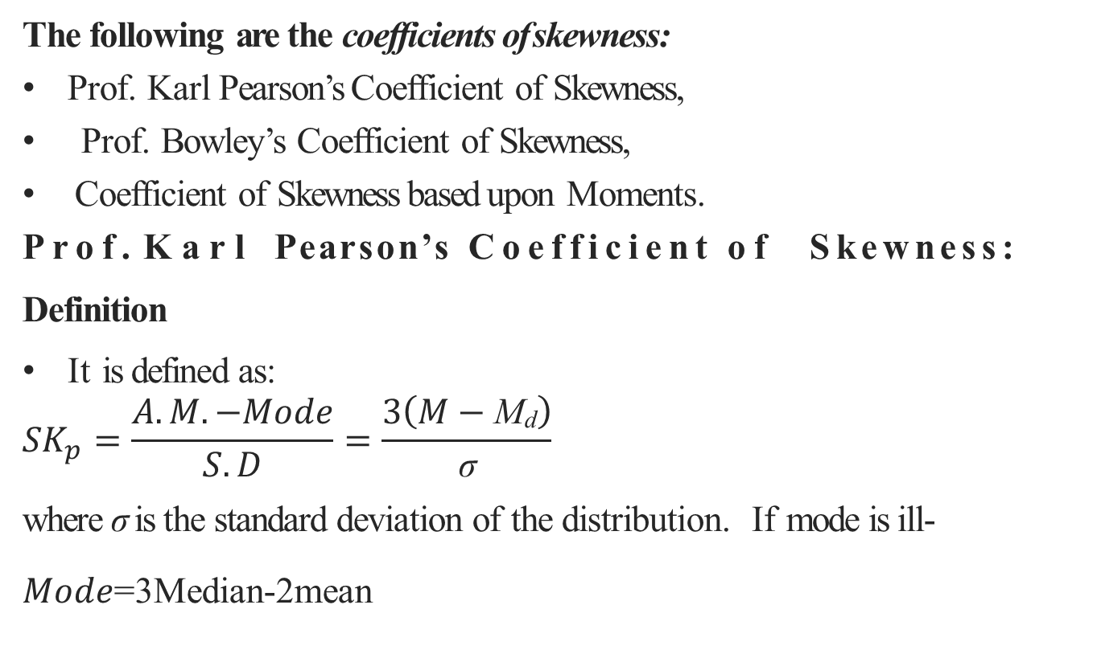
Skewness(CO1)
The following are the coefficients of skewness:
Prof. Karl Pearson’s Coefficient of Skewness,
Prof. Bowley’s Coefficient of Skewness,
Coefficient of Skewness based upon Moments.
Prof. Karl Pearson’s Coefficient of Skewness:
Definition
It is defined as:
$${SK}_{p}=\frac{A.M.−Mode}{S.D}=\frac{3\left(M−\text{M}\text{d}\right)}{\text{σ}}$$
where σ is the standard deviation of the distribution. If mode is ill-
$Mode$=3Median-2mean

Slide 70
Skewness(CO1)
defined, then using the empirical relation,
M_{o} = 3M_{d} − 2M, for a moderately asymmetrical distribution, we have
From above two formulas, we observe that S_{k} = 0 if M = M_{o} = M_{d} .
Hence for a symmetrical distribution, mean, median and mode coincide.
Skewness is positive if M > M_{o} or M > M_{d} , and negative if M < M_{o} or M < M_{d} .
Limits are: |S_{k} | ≤ 3 or −3 ≤ S_{k} ≤ 3.
However, in practice, these limits are rarely attained.

Slide 71
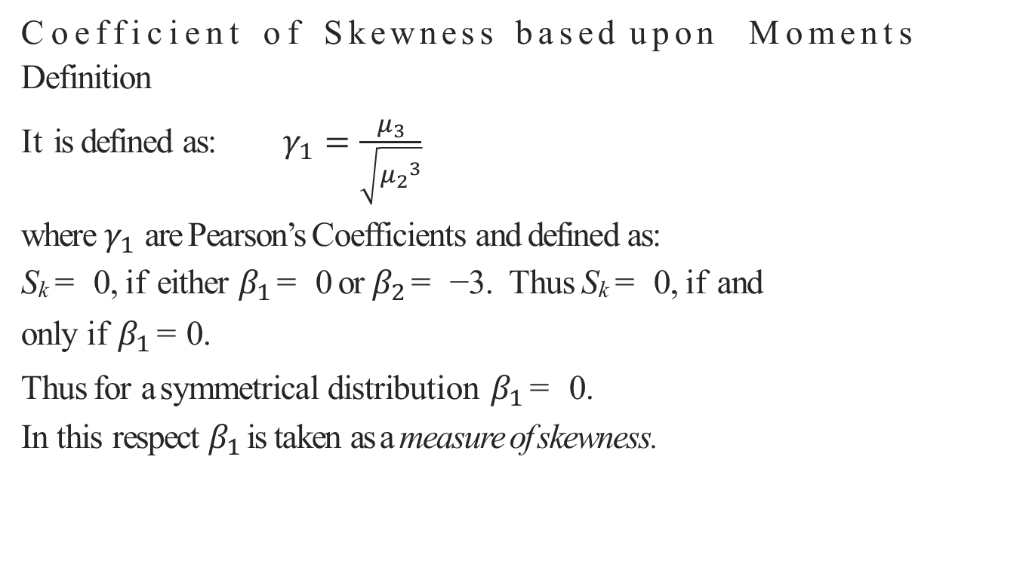
Skewness(CO1)
Coefficient of Skewness based upon Moments
Definition
It is defined as:$γ_{1}=\frac{μ_{3}}{\sqrt{{μ_{2}}_{ }^{3}}}$
where $γ_{1}$ are Pearson’s Coefficients and defined as:
S_{k} = 0, if either $β_{1}$ = 0 or $β_{2}$ = −3. Thus S_{k} = 0, if and only if $β_{1}$ = 0.
Thus for a symmetrical distribution $β_{1}$ = 0.
In this respect $β_{1}$ is taken as a measure of skewness.

Slide 72
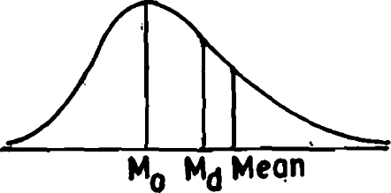
Skewness(CO1)
The coefficient of skewness based upon moments is to be regarded as without sign.
The Pearson’s and Bowley’s coefficients of skewness can be positive as well as negative.
Positively Skewed Distribution: The skewness is positive if the larger tail of the distribution lies towards the higher values of the variate (the right),i.e., if the curve drawn
with the help of the given data is
stretched more to the right than
to the left.

Slide 73
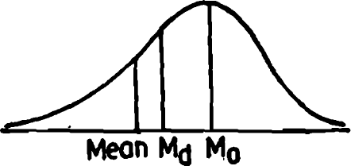
Skewness(CO1)
Negatively Skewed Distribution:
The skewness is negative if the larger tail of the distribution lies towards the lower values of the variate (the left), i.e., if the curve drawn with the help of the given data is stretched more to the left than to the right.

Slide 74
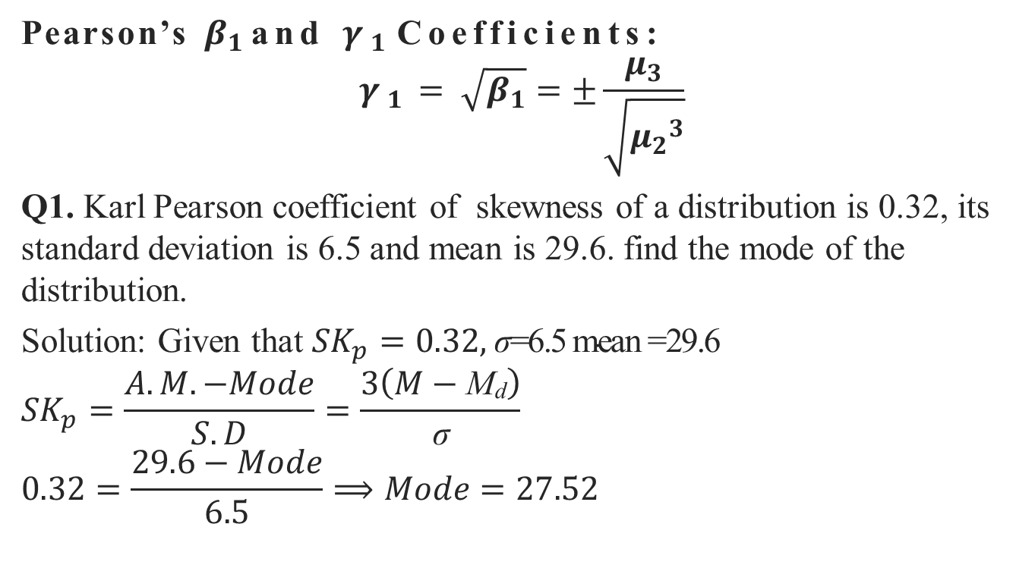
Skewness(CO1)
Pearson’s $β_{1}$ and $γ_{1}$ Coefficients:
$$γ_{1}=\sqrt{β_{1}}=±\frac{μ_{3}}{\sqrt{{μ_{2}}_{ }^{3}}}$$
Q1. Karl Pearson coefficient of skewness of a distribution is 0.32, its standard deviation is 6.5 and mean is 29.6. find the mode of the distribution.
Solution: Given that ${SK}_{p}=0.32,$ $\text{σ}\text{=6.5 }\text{mean}\text{ =29.6}$
$${SK}_{p}=\frac{A.M.−Mode}{S.D}=\frac{3\left(M−\text{M}\text{d}\right)}{\text{σ}}$$
$$0.32=\frac{29.6−Mode}{6.5}⟹Mode=27.52$$

Slide 75
Topic objective (CO1)
Kurtosis
Describe the concepts of kurtosis
Explain the different measures of kurtosis
Explain how kurtosis describe the shape of a distribution.

Slide 76
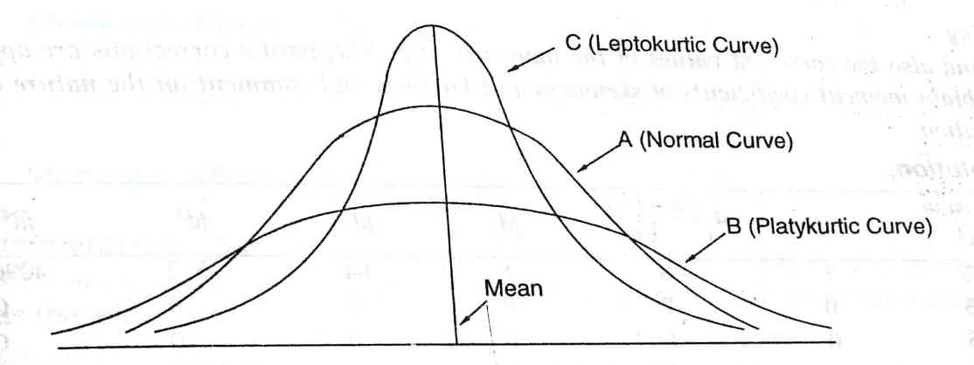
Kurtosis (CO1)
Kurtosis
If we know the measures of central tendency, dispersion and skewness, we still cannot form a complete idea about the distribution. Let us consider the figure in which all the three curves
A, B, and C are symmetrical about the mean and have the same range.

Slide 77
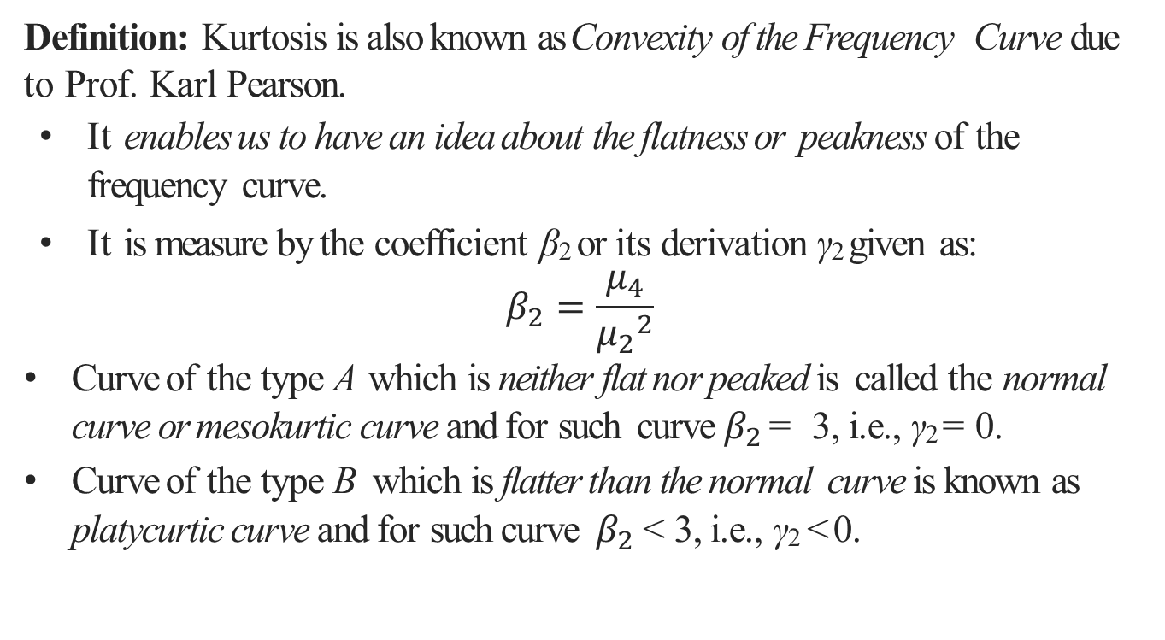
Kurtosis (CO1)
Definition: Kurtosis is also known as Convexity of the Frequency Curve due to Prof. Karl Pearson.
It enables us to have an idea about the flatness or peakness of the frequency curve.
It is measure by the coefficient β₂ or its derivation γ₂ given as:
$$β_{2}=\frac{μ_{4}}{{μ_{2}}^{2}}$$
Curve of the type A which is neither flat nor peaked is called the normal curve or mesokurtic curve and for such curve $β_{2}$ = 3, i.e., γ₂ = 0.
Curve of the type B which is flatter than the normal curve is known as platycurtic curve and for such curve $β_{2}$ < 3, i.e., γ₂ < 0.

Slide 78
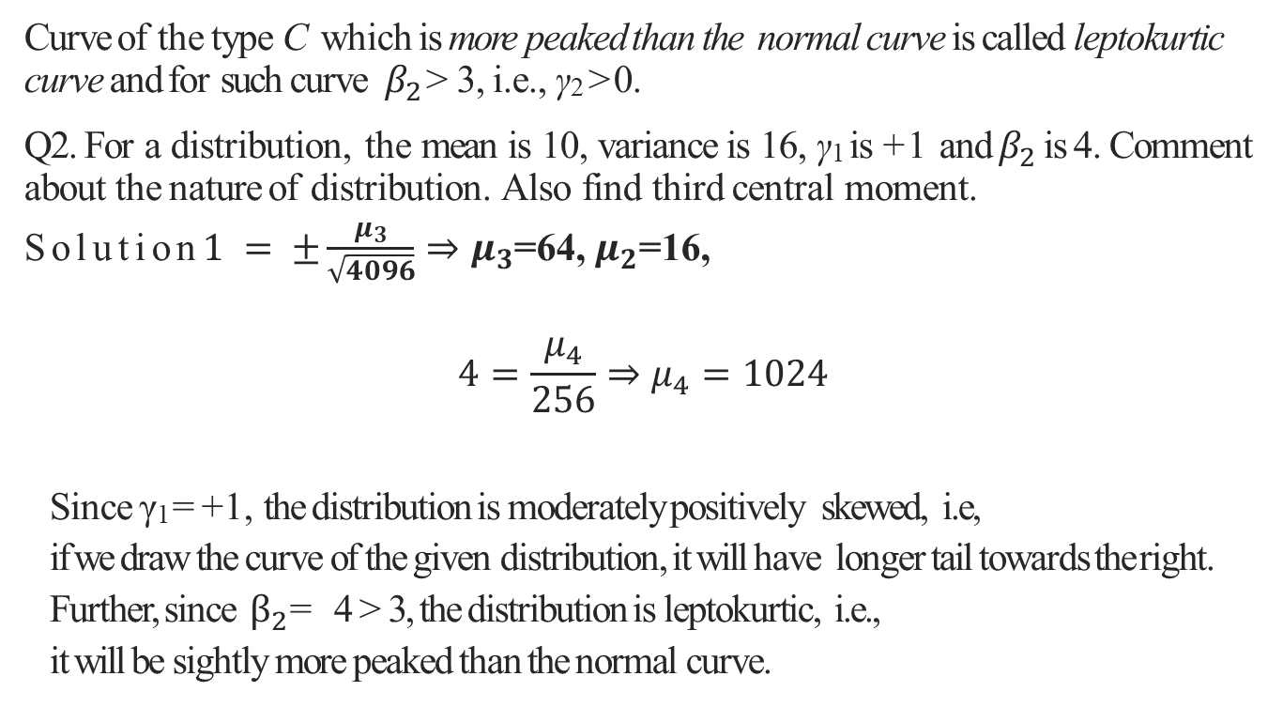
Kurtosis (CO1)
Curve of the type C which is more peaked than the normal curve is called leptokurtic curve and for such curve $β_{2}$> 3, i.e., γ₂ > 0.
Q2. For a distribution, the mean is 10, variance is 16, γ₁ is +1 and $β_{2}$ is 4. Comment about the nature of distribution. Also find third central moment.
Solution$1=±\frac{μ_{3}}{\sqrt{4096}}⇒μ_{3}$=64, $μ_{2}$=16,
$$4=\frac{μ_{4}}{256}⇒μ_{4}=1024$$
Since γ₁ =+1, the distribution is moderately positively skewed, i.e,
if we draw the curve of the given distribution, it will have longer tail towards the right.
Further, since $β_{2}$= 4 > 3, the distribution is leptokurtic, i.e.,
it will be sightly more peaked than the normal curve.

Slide 79
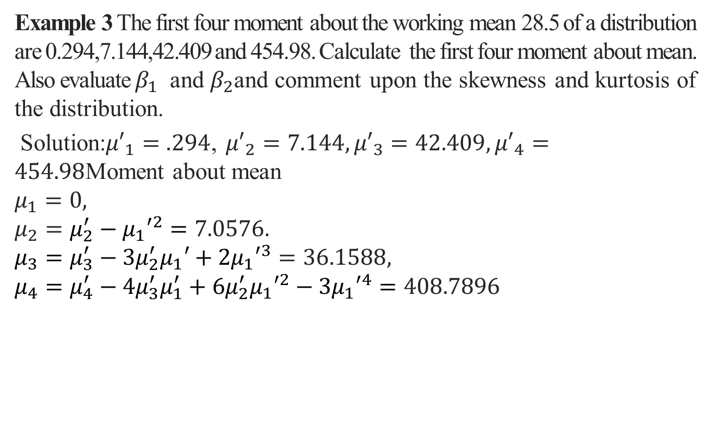
Kurtosis (CO1)
Example 3 The first four moment about the working mean 28.5 of a distribution are 0.294,7.144,42.409 and 454.98. Calculate the first four moment about mean. Also evaluate $β_{1}$ and $β_{2}$and comment upon the skewness and kurtosis of the distribution.
Solution:${μ′}_{1}=.294$, ${μ′}_{2}=7.144,{μ′}_{3}=42.409,{μ′}_{4}=454.98$Moment about mean
$$μ_{1}=0,$$
$$μ_{2}=μ_{2}^{′}−{μ_{1}′}^{2}=7.0576.$$
$$μ_{3}=μ_{3}^{′}−3μ_{2}^{′}μ_{1}′+2{μ_{1}′}^{3}=36.1588,$$
$$μ_{4}=μ_{4}^{′}−4μ_{3}^{′}μ_{1}^{′}+6μ_{2}^{′}{μ_{1}′}^{2}−3{μ_{1}′}^{4}=408.7896$$

Slide 80
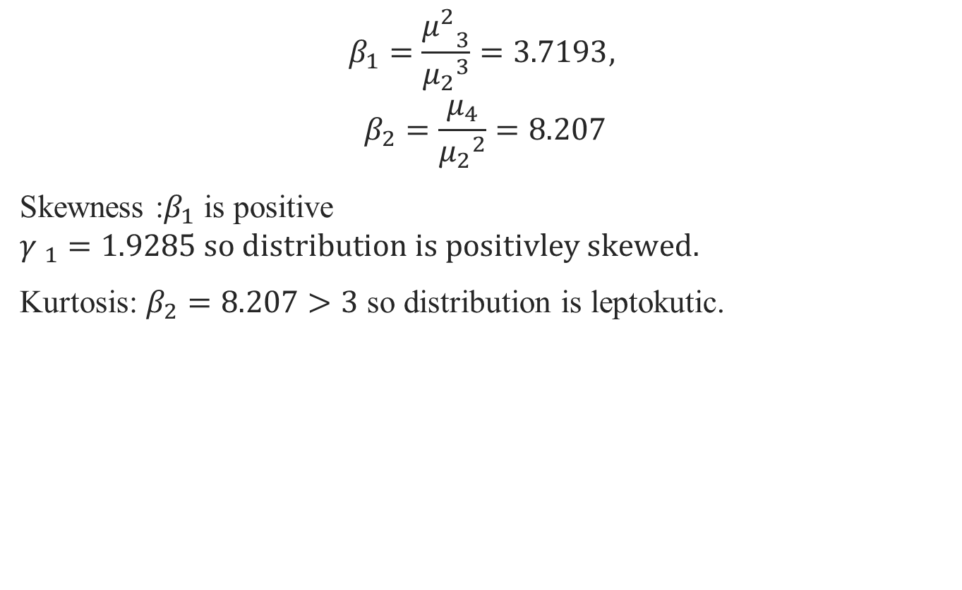
Kurtosis (CO 1)
$$β_{1}=\frac{{μ^{2}}_{3}}{{μ_{2}}_{ }^{3}}=3.7193,$$
$$β_{2}=\frac{μ_{4}}{{μ_{2}}^{2}}=8.207$$
Skewness :$β_{1}$ is positive ${γ }_{1}=1.9285 so distribution is positivley skewed.$
Kurtosis: $β_{2}=8.207>3$ so distribution is leptokutic.

Slide 81
Daily Quiz(CO1)
Q1. Find all four central moments and Discuss Skewness and Kurtosis for the following distribution-
Range of Expenditures | 2-4 | 4-6 | 6-8 | 8-10 | 10-12
No. of families | 38 | 292 | 389 | 212 | 69

Slide 82
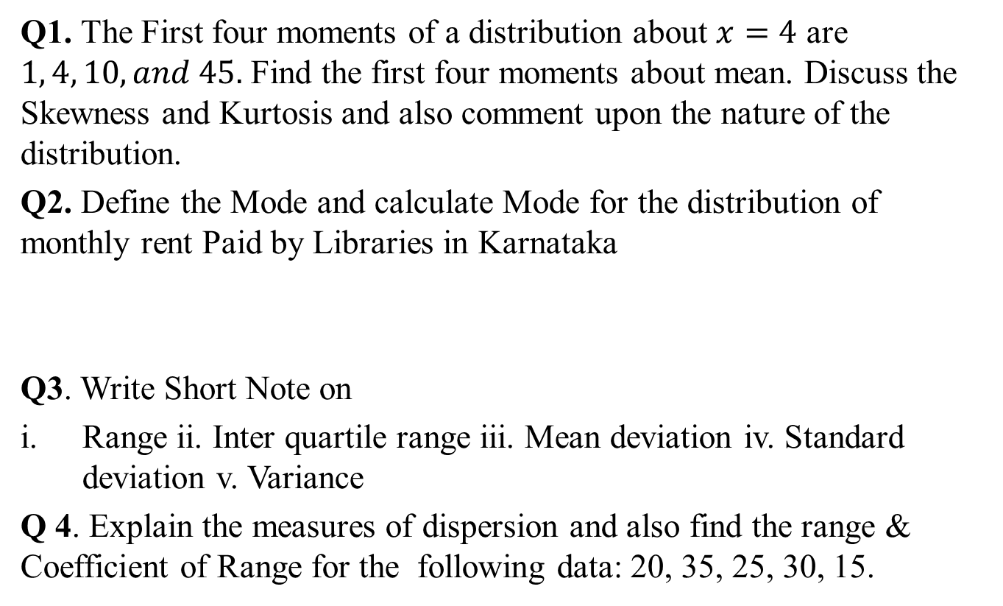
Weekly Assignment(CO1)
Q1. The First four moments of a distribution about $x=4$ are $1, 4, 10, and 45.$ Find the first four moments about mean. Discuss the Skewness and Kurtosis and also comment upon the nature of the distribution.
Q2. Define the Mode and calculate Mode for the distribution of monthly rent Paid by Libraries in Karnataka
Q3. Write Short Note on
Range ii. Inter quartile range iii. Mean deviation iv. Standard deviation v. Variance
Q 4. Explain the measures of dispersion and also find the range & Coefficient of Range for the following data: 20, 35, 25, 30, 15.
Monthly rent | 500-1000 | 1000-1500 | 1500-2000 | 2000-2500 | 2500-3000 | 3000 & above
No.of Library | 5 | 10 | 8 | 16 | 14 | 12

Slide 83
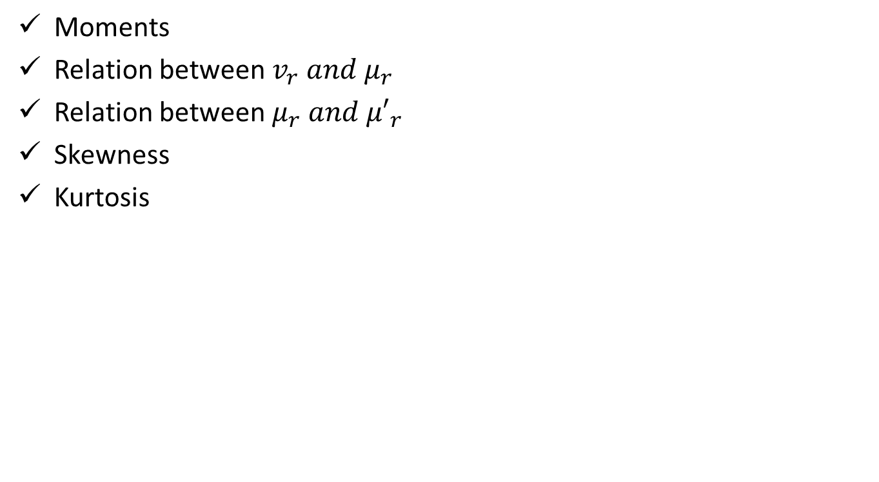
Recap(CO1)
Moments
Relation between $v_{r} and μ_{r}$
Relation between $μ_{r} and {μ′}_{r}$
Skewness
Kurtosis

Slide 84
Topic objectives(CO1)
Curve Fitting
The objective of curve fitting is to find the parameters of a mathematical model that describes a set of data in a way that minimizes the difference between the model and the data.

Slide 85
Curve Fitting (CO1)
Curve Fitting :Curve fitting means an exact relationship between two variables by algebraic equation. It enables us to represent the relationship between two variables by simple algebraic expressions e.g. polynomials, exponential or logarithmic functions. .It is also used to estimate the values of one variable corresponding to the specified values of other variables.
Method of Least Squares: Method of least squares provides a unique set of values to the constants and hence suggests a curve of best fit to the given data.

Slide 86
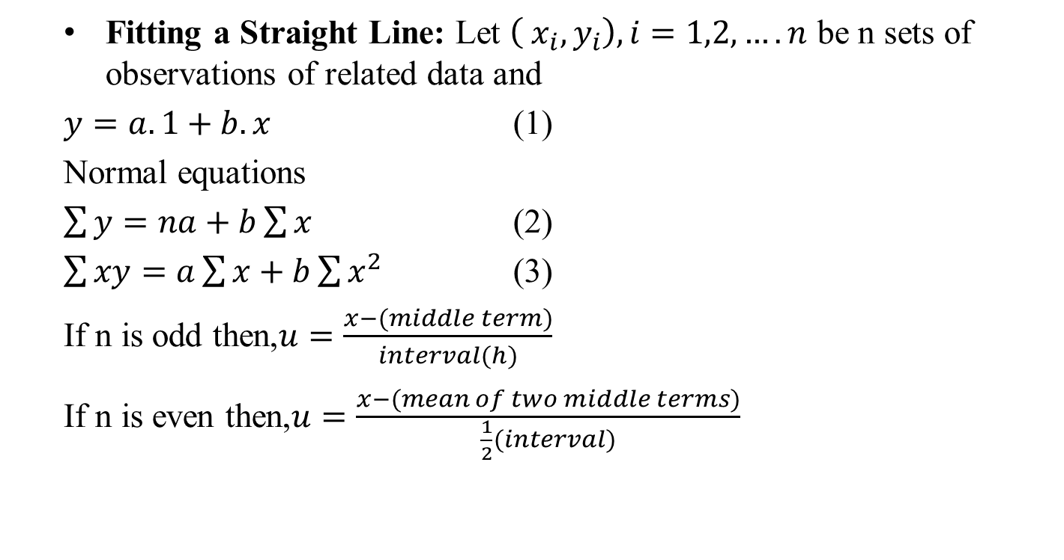
Curve Fitting (CO1)
Fitting a Straight Line: Let $\left( x_{i},y_{i}\right),i=1,2,….n$ be n sets of observations of related data and
$y=a.1+b.x$ (1)
Normal equations
$\sum{y}=na+b\sum{x}$ (2)
$\sum{xy}=a\sum{x}+b\sum{x^{2}}$ (3)
If n is odd then,$u=\frac{x−(middle term)}{interval(h)}$
If n is even then,$u=\frac{x−(mean of two middle terms)}{\frac{1}{2}(interval)}$

Slide 87
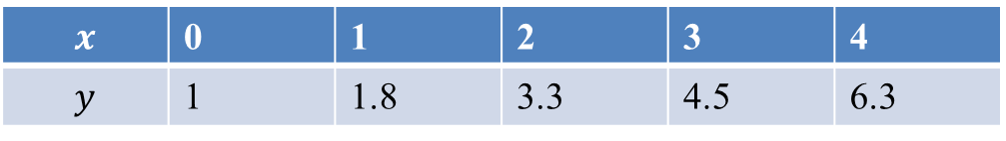
Curve Fitting (CO1)
Q.Fit a straight line to the following data by least square method.
Sol. Let the straight line obtained from the given data be
$y=a.1+bx$ (1)
then the normal equations are
$\sum{y}=ma+b\sum{x}$ (2)
$\sum{xy}=a\sum{x}+b\sum{x^{2}}$ (3) m=5
$$x$$ | 0 | 1 | 2 | 3 | 4
$$y$$ | 1 | 1.8 | 3.3 | 4.5 | 6.3

Slide 88
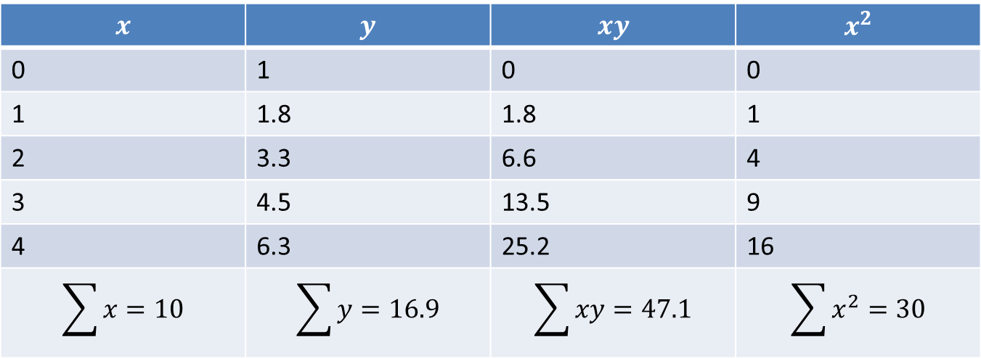
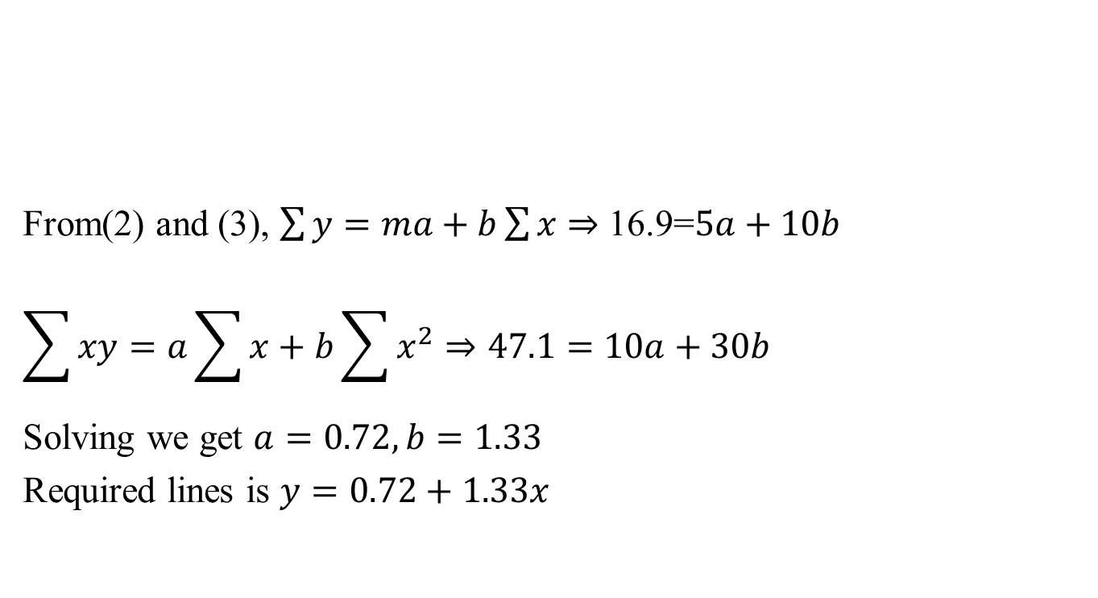
Curve Fitting (CO1)
From(2) and (3), $\sum{y}=ma+b\sum{x}⇒$ 16.9=$5a+10b$
$$\sum{xy}=a\sum{x}+b\sum{x^{2}}⇒47.1=10a+30b$$
Solving we get $a=0.72,b=1.33$
Required lines is $y=0.72+1.33x$

Slide 89
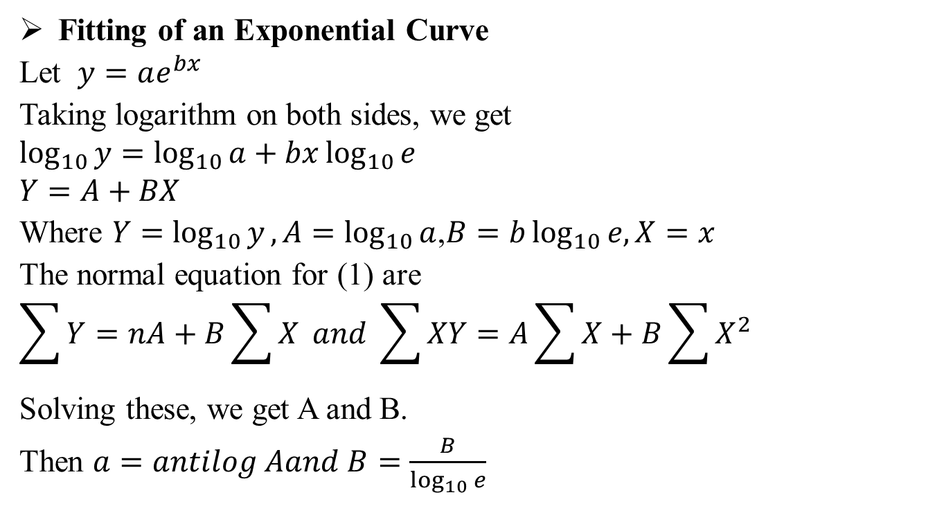
Curve Fitting (CO1)
Fitting of an Exponential Curve
Let $y=ae^{bx}$
Taking logarithm on both sides, we get
$$\log_{10}{y}=\log_{10}{a}+bx\log_{10}{e}$$
$$Y=A+BX$$
Where $Y=$ $\log_{10}{y},A=\log_{10}{a}$,$B=b\log_{10}{e,X=x}$
The normal equation for (1) are
$$\sum{Y}=nA+B\sum{X} and \sum{XY}=A\sum{X}+B\sum{X^{2}}$$
Solving these, we get A and B.
Then $a=antilog Aand B=\frac{B}{\log_{10}{e}}$

Slide 90

Curve Fitting (CO1)
FITTING OF THE CURVE
Let $y=ax^{b}$
Taking logarithm on both sides, we get
$$\log_{10}{y}=\log_{10}{a}+b\log_{10}{x}$$
$$Y=A+BX$$
Where $Y=$ $\log_{10}{y},A=\log_{10}{a}$,$B=b{,X=}\log_{10}{x}$
The normal equation to (1) are
$$\sum{Y}=nA+B\sum{X} and \sum{XY}=A\sum{X}+B\sum{X^{2}}$$
Which results A and B on solving and $a=antilog A,b=B.$

Slide 91

Curve Fitting (CO1)
Example Use the method of least squares to the fit the curve:
$y=\frac{c_{0}}{x}+c_{1}\sqrt{x}$ to the following table of values:
Solution: Let given curve is $y=\frac{c_{0}}{x}+c_{1}\sqrt{x}$
Normal equations are
$$\sum{\frac{y}{x}=c_{0}\sum{\frac{1}{x^{2}}+c_{1}\sum{\frac{1}{\sqrt{x}}}}}$$
$$\sum{y\sqrt{x}}=c_{0}\sum{\frac{1}{\sqrt{x}}}+c_{1}\sum{x}.$$
X | 0.1 | 0.2 | 0.4 | 0.5 | 1 | 2
Y | 21 | 11 | 7 | 6 | 5 | 6

Slide 92

Curve Fitting (CO1)
$$302.5=136.5c_{0}+10.10081c_{1}$$
$$x$$ | $$y$$ | $$\frac{y}{x}$$ | $$y\sqrt{x}$$ | $$\frac{1}{\sqrt{x}}$$ | $$\frac{1}{x^{2}}$$
0.1 | 21 | 210 | 6.64078 | 3.16228 | 100
0.2 | 11 | 55 | 4.91935 | 2.23607 | 25
0.4 | 7 | 17.5 | 4.42719 | 1.58114 | 6.25
0.5 | 6 | 12 | 4.24264 | 1.41421 | 4
1 | 5 | 5 | 5 | 1 | 1
2 | 6 | 3 | 8.48528 | 0.70711 | 0.25
4.2 |  | 302.5 | 33.71524 | 10.10081 | 136.5

Slide 93

Curve Fitting (CO1)
$$33,71524=10.10081c_{0}+4.2c_{1}$$
so we have
$$c_{0}=1.97327,c_{1}=3.28182$$
Hence the curve is
$$y=\frac{1.97327}{x}+3.28182\sqrt{x}$$

Slide 94

Daily Quiz(CO1)
Q Fit a second degree parabola to the following data-
$$x$$ | 0 | 1 | 2 | 3 | 4
$$f$$ | 1 | 0 | 3 | 10 | 21

Slide 95

Recap(CO1)
Moments
Relation between $v_{r} and μ_{r}$
Relation between $μ_{r} and {μ′}_{r}$
Skewness & kurtosis
Curve fitting

Slide 96
Topic objective (CO1)
Correlation
Identify the direction and strength of a correlation between two factors.
Compute and interpret the Pearson correlation coefficient and test for significance.
Compute and interpret the coefficient of determination.
Compute and interpret the Spearman correlation coefficient and test for significance.

Slide 97
Correlation(CO1)
Correlation: In a bivariate distribution we are interested to find out i f there is any correlation between the two variables under study.
If the change in one variable affects a change in the other variable, the variables are said to be correlated.
Positive Correlation
If the two variables deviate in the same direction, i.e., if the increase (or decrease) in one results in a corresponding increase (or decrease) in the other, correlation is said to be direct or positive.
For example, the correlation between (i) the heights and weights of a group of persons, and (ii) the income and expenditure; is positive.

Slide 98
Correlation(CO1)
Negative Correlation:
If the two variables deviate in the opposite directions, i.e., if increase (or decrease) in one results in corresponding decrease (or increase) in the other, correlation is said to be diverse or negative.
For example, the correlation between (i) the price and demand of a commodity, and (ii) the volume and pressure of a perfect gas; is negative.
Perfect Correlation:
Correlation is said to be perfect if the deviation in one variable is followed by a corresponding and proportional deviation in the other.

Slide 99

Correlation(CO1)
Correlation Coefficient:
The correlation coefficient due to Karl Pearson is defined as a measure of intensity or degree of linear relationship between two variables.
Karl Pearson’s Correlation Coefficient
Karl Pearson’s correlation coefficient between two variables X and Y , is denoted by r (X, Y ) or r_{XY} , is a measure of linear relationship between them and is defined as:
r (X, Y ) =$\frac{Cov(x,y)}{\text{σ}\text{X} \text{σ}\text{Y} }$
f (x_{i}, y_{i} ); i = 1, 2, ..., n is the bivariate distribution, then
Cov (X, Y ) = E [{X − E (X )}{Y − E (Y )}]

Slide 100

Correlation(CO1)
Karl Pearson’s Co –Efficient Of Correlation(or Product Moment Correlation Co-efficient)
Correlation co-efficient between two variable $x and y,$ usually denoted by $r\left(x,y\right)or r_{xy}$ is a numerical measure of linear relationship between them and defined as
$$r_{xy}=\frac{\sum{\left(x_{i}−\overline{x}\right)\left(y_{i}−\overline{y}\right)}}{\sqrt{\sum{{\left(x_{i}−\overline{x}\right)}^{2}{\sum{ }\left(y_{i}−\overline{y}\right)}^{2}}}}$$
$$=\frac{\frac{1}{n}\sum{\left(x_{i}−\overline{x}\right)\left(y_{i}−\overline{y}\right)}}{\sqrt{\frac{1}{n}\sum{{\left(x_{i}−\overline{x}\right)}^{2}.\frac{1}{n}{\sum{ }\left(y_{i}−\overline{y}\right)}^{2}}}}$$

Slide 101

Correlation(CO1)
$$=\frac{\frac{1}{n}\sum{\left(x_{i}−\overline{x}\right)\left(y_{i}−\overline{y}\right)}}{σ_{x}σ_{y}}$$
$$r_{xy}=\frac{\sum{\left(x−\overline{x}\right)\left(y−\overline{y}\right)}}{nσ_{x}σ_{y}}$$
Or $r\left(x,y\right)=\frac{n\sum{xy}−\sum{x}\sum{y}}{\sqrt{n\sum{x^{2}−{\left(\sum{x}\right)}^{2}}}\sqrt{n\sum{y^{2}−{\left(\sum{y}\right)}^{2}}}}$
Here $n$is the no. of pairs of values of $x and y.$
Note: Correlation co efficient is independent of change of origin and scale.
Let us define two new variables $u and v as$
$u=\frac{x−a}{h},v=\frac{y−b}{k}$where $a,b,h,k are constant then r_{xy}=r_{uv}$
Then $r\left(u,v\right)=$ $\frac{n\sum{uv}−\sum{u}\sum{v}}{\sqrt{n\sum{u^{2}−{\left(\sum{u}\right)}^{2}}}\sqrt{n\sum{v^{2}−{\left(\sum{v}\right)}^{2}}}}$

Slide 102



Correlation(CO1)
Q.Find the coefficient of correlation between the values of $x and y:$
Sol. Here $n=6.$ The table is as follows.
$$x$$ | 1 | 3 | 5 | 7 | 8 | 10
$$y$$ | 8 | 12 | 15 | 17 | 18 | 20
$$x$$ | $$y$$ | $$x^{2}$$ | $$y^{2}$$ | $$xy$$
1 | 8 | 1 | 64 | 8
3 | 12 | 9 | 144 | 36
5 | 15 | 25 | 225 | 75
7 | 17 | 49 | 289 | 119
8 | 18 | 64 | 324 | 144
10 | 20 | 100 | 400 | 200
$$\sum{x=34}$$ | $$\sum{y=90}$$ | $$\sum{x^{2}=248}$$ | $$\sum{y^{2}=1446}$$ | $$\sum{xy=582}$$

Slide 103


Correlation(CO1)
Karl Pearson’s coefficient of correlation is given by
$$r\left(x,y\right)=\frac{n\sum{xy}−\sum{x}\sum{y}}{\sqrt{n\sum{x^{2}−{\left(\sum{x}\right)}^{2}}}\sqrt{n\sum{y^{2}−{\left(\sum{y}\right)}^{2}}}}$$
$$r\left(x,y\right)=\frac{\left(6×582\right)−\left(34×90\right)}{\sqrt{\left(6×248\right)−{\left(34\right)}^{2}}\sqrt{\left(6×1446\right)−{\left(90\right)}^{2}}}=0.9879$$
Q. Find the co-efficient of correlation for the following table:
Solution: Let $u=\frac{x−22}{4},v=\frac{y−24}{6}$
$$x$$ | 10 | 14 | 18 | 22 | 26 | 30
$$y$$ | 18 | 12 | 24 | 6 | 30 | 36

Slide 104

Correlation(CO1)
$$x$$ | $$y$$ | $$u$$ | $$v$$ | $$u^{2}$$ | $$v^{2}$$ | $$uv$$
10 | 18 | -3 | -1 | 9 | 1 | 3
14 | 12 | -2 | -2 | 4 | 4 | 4
18 | 24 | -1 | 0 | 1 | 0 | 0
22 | 6 | 0 | -3 | 0 | 9 | 0
26 | 30 | 1 | 1 | 1 | 1 | 1
30 | 36 | 2 | 2 | 4 | 4 | 4
Total |  | $$\sum{u}=−3$$ | $$\sum{v}=−3$$ | $$\sum{u^{2}=19}$$ | $$\sum{v^{2}=19}$$ | $$\sum{uv}=12$$

Slide 105

Correlation(CO1)
Hence,n=6,$\overline{u}=\frac{1}{n}\sum{u=\frac{1}{6}\left(−3\right)=−\frac{1}{2};}\overline{v}=\frac{1}{n}\sum{v}=\frac{1}{6}\left(−3\right)=−\frac{1}{2}$
Then $r_{uv}=$ $\frac{n\sum{uv}−\sum{u}\sum{v}}{\sqrt{n\sum{u^{2}−{\left(\sum{u}\right)}^{2}}}\sqrt{n\sum{v^{2}−{\left(\sum{v}\right)}^{2}}}}$
$$=\frac{\left(6×12\right)−\left(−3\right)\left(−3\right)}{\sqrt{\left(6×19\right)−{\left(−3\right)}^{2}}\sqrt{\left(6×19\right)}−{\left(−3\right)}^{2}}=\frac{63}{\sqrt{105}\sqrt{105}}=0.6$$
Calculation of co-efficient of correlation for a bivariate frequency distribution.
If the bivariate data on $x and y$is presented on a two way correlation table and $f$is the frequency of a particular rectangle
In the correlation table then

Slide 106

Correlation(CO1)
$$r_{xy}=\frac{\sum{fxy}−\frac{1}{n}\sum{fx}\sum{fy}}{\sqrt{\sum{fx^{2}−\frac{1}{n}{\left(\sum{fx}\right)}^{2}}\left[\sum{{fy}^{2}−\frac{1}{n}{\left(\sum{fy}\right)}^{2}}\right]} }$$
Since change of origin and scale do not affect the co-efficient of correlation.$r_{xy}=r_{uv}$where the new variables $u,v$ are properly chosen.
Q. The following table given according to age the frequency of marks obtained by 100 students is an intelligence test:

Slide 107

Correlation(CO1)
Calculate the coefficient of correlation between age and intelligence.
Solution: Age and intelligence be denoted by $x and y$ respectively.
Marks | 18 | 19 | 20 | 21 | total
10-20 | 4 | 2 | 2 |  | 8
20-30 | 5 | 4 | 6 | 4 | 19
30-40 | 6 | 8 | 10 | 11 | 35
40-50 | 4 | 4 | 6 | 8 | 22
50-60 |  | 2 | 4 | 4 | 10
60-70 |  | 2 | 3 | 1 | 6
Total | 19 | 22 | 31 | 28 | 100

Slide 108

Correlation(CO1)
$$Mid$$ $$value$$ | x$⟶$ y$↓$ | 18 | 19 | 20 | 21 | $$f$$ | $$u=\frac{y−45}{10}$$ | $$fu$$ | f$u^{2}$ | $$fuv$$
15 | 10-20 | 4 | 2 | 2 |  | 8 | -3 | -24 | 72 | 30
25 | 20-30 | 5 | 4 | 6 | 4 | 19 | -2 | -38 | 76 | 20
35 | 30-40 | 6 | 8 | 10 | 11 | 35 | -1 | -35 | 35 | 9
45 | 40-50 | 4 | 4 | 6 | 8 | 22 | 0 | 0 | 0 | 0
55 | 50-60 |  | 2 | 4 | 4 | 10 | 1 | 10 | 10 | 2
65 | 60-70 |  | 2 | 3 | 1 | 6 | 2 | 12 | 24 | -2
 | $$f$$ | 19 | 22 | 31 | 28 | 100 | total | -75 | 217 | 59
 | $$v=x−20$$ | -2 | -1 | 0 | 1 | Total
 | $$fv$$ | -38 | -22 | 0 | 28 | -32
 | $${fv}^{2}$$ | 76 | 22 | 0 | 28 | 126
 | $$fuv$$ | 56 | 16 | 0 | -13 | 59

Slide 109

Correlation(CO1)
Let us define two new variables $u and v as u=\frac{y−45}{10},v=x−20$
$$r_{xy}=r_{uv}=\frac{\sum{fuv}−\frac{1}{n}\sum{fu}\sum{fv}}{\sqrt{\sum{fu^{2}−\frac{1}{n}{\left(\sum{fu}\right)}^{2}}\left[\sum{{fv}^{2}−\frac{1}{n}{\left(\sum{fv}\right)}^{2}}\right]} }$$
$$=\frac{59−\frac{1}{100}\left(−75\right)\left(−32\right)}{\sqrt{\left[217−\frac{1}{100}{\left(−75\right)}^{2}\right]\left[126−\frac{1}{100}{\left(−32\right)}^{2}\right]}}=\frac{59−24}{\sqrt{\frac{643}{4}×\frac{2894}{25}}}=0.25$$

Slide 110

Rank Correlation(CO1)
RANK CORRELATION:
Definition: Assuming that no two individuals are bracketed equal in either classification, each of the variables X and Y takes the values 1, 2, ..., n.
Hence, the rank correlation coefficient between A and Bis denoted by r, and is given as:
$$r=1−\left[\frac{6\sum{{D_{i}}^{2}}}{n\left(n^{2}−1\right)}\right]$$

Slide 111

Rank Correlation(CO1)
Question. Compute the rank correlation coefficient for the following data.
Sol. Here the ranks are given and $n=10$
Person | A | B | C | D | E | F | G | H | I | J
Rank in maths | 9 | 10 | 6 | 5 | 7 | 2 | 4 | 8 | 1 | 3
Rank in physics | 1 | 2 | 3 | 4 | 5 | 6 | 7 | 8 | 9 | 10

Slide 112

Rank Correlation(CO1)
Person | $$R_{1}$$ | $$R_{2}$$ | D=$R_{1}−R_{2}$ | $$D^{2}$$
A | 9 | 1 | 8 | 64
B | 10 | 2 | 8 | 64
C | 6 | 3 | 3 | 9
D | 5 | 4 | 1 | 1
E | 7 | 5 | 2 | 4
F | 2 | 6 | -4 | 16
G | 4 | 7 | -3 | 9
H | 8 | 8 | 0 | 0
I | 1 | 9 | -8 | 64
J | 3 | 10 | -7 | 49
 |  |  |  | $$\sum{D^{2}=280}$$

Slide 113

Rank Correlation(CO1)
$$r=1−\left[\frac{6\sum{D^{2}}}{n\left(n^{2}−1\right)}\right]=1−\left[\frac{6×280}{10\left(100−1\right)}\right]=1−1.697=−0.697$$
Uses:
It is used for finding correlation coefficient if we are dealing with qualitative characteristics which cannot be measured quantitatively but can be arranged serially.
It can also be used where actual data are given.
In case of extreme observations, Spearman’s formula is preferred to Pearson’s formula.
Limitations:
It is not applicable in the case of bivariate frequency distribution.

Slide 114

Tied Correlation(CO1)
For n > 30, this formula should not be used unless the ranks are given, since in the contrary case the calculations are quite time-consuming.
TIED RANKS: If some of the individuals receive the same rank in a ranking of merit, they are said to be tied.
Let us suppose that m of the individuals, say, (k + 1)^{th}, (k + 2)^{th}, ..., (k + m)^{th}, are tied.
Then each of these m individuals assigned a common rank, which is arithmetic mean of the ranks k + 1, k + 2, ..., k + m.
$$r=1−\frac{6\left\{\sum{D^{2}+\frac{1}{12}m_{1}\left({m_{1}}^{2}−1\right)+\frac{1}{12}m_{2}\left({m_{2}}^{2}−1\right)+…}\right\}}{n\left(n^{2}−1\right)}$$

Slide 115

Tied Correlation(CO1)
Question: Obtain the rank correlation co-efficient for the following data:
Solution: Here marks are given so write down the ranks
$$x$$ | 68 | 64 | 75 | 50 | 64 | 80 | 75 | 40 | 55 | 64
$$y$$ | 62 | 58 | 68 | 45 | 81 | 60 | 68 | 48 | 50 | 70

Slide 116

Tied Correlation(CO1)
75
75 2 times
64 3 times
68 2 times
$$X$$ | 68 | 64 | 75 | 50 | 64 | 80 | 75 | 40 | 55 | 64 | Total
$$Y$$ | 62 | 58 | 68 | 45 | 81 | 60 | 68 | 48 | 50 | 70
Ranks in $X(x)$ | 4 | 6 | 2.5 | 9 | 6 | 1 | 2.5 | 10 | 8 | 6
Ranks in $Y(y)$ | 5 | 7 | 3.5 | 10 | 1 | 6 | 3.5 | 9 | 8 | 2
$$D=x−y$$ | -1 | -1 | -1 | -1 | 5 | -5 | -1 | 1 | 0 | 4 | 0
$$D^{2}$$ | 1 | 1 | 1 | 1 | 25 | 25 | 1 | 1 | 0 | 16 | 72

Slide 117

Tied Correlation(CO1)
$$r=1−\frac{6\left\{\sum{D^{2}+\frac{1}{12}m_{1}\left({m_{1}}^{2}−1\right)+\frac{1}{12}m_{2}\left({m_{2}}^{2}−1\right)+\frac{1}{12}m_{3}\left({m_{3}}^{2}−1\right)}\right\}}{n\left(n^{2}−1\right)}$$
$$=1−\frac{6\left\{72+\frac{1}{12}.2\left(2^{2}−1\right)+\frac{1}{12}.3\left(3^{2}−1\right)+\frac{1}{12}.2\left(2^{2}−1\right)\right\}}{10\left({10}^{2}−1\right)}$$
$$=1−\left\{\frac{6×75}{990}\right\}=\frac{6}{11}=0.545$$

Slide 118

Daily Quiz(CO1)
Q1. Find the rank correlation coefficient for the following data:
$$x$$ | 23 | 27 | 28 | 28 | 29 | 30 | 31 | 33 | 35 | 36
$$y$$ | 18 | 20 | 22 | 27 | 21 | 29 | 27 | 29 | 28 | 29

Slide 119
Recap(CO1)
Correlation
Karl Pearson coefficient of correlation
Rank Correlation
Tied Rank

Slide 120
Topic objectives (CO1)
Regression
Explanation of the variation in the dependent variable, based on the variation in independent variables and Predict the values of the dependent variable.

Slide 121

Regression Analysis(CO1)
REGRESSION ANALYSIS:
Regression measures the nature and extent of correlation .Regression is the estimation or prediction of unknown values of one variable from known values of another variable.
Difference between curve fitting and regression analysis: The only fundamental difference, if any between problems of curve fitting and regression is that in regression, any of the variables may be considered as independent or dependent while in curve fitting, one variable cannot be dependent.
Curve of regression and regression equation:
If two variates $x and y$ are correlated i.e., there exists an association or relationship between them, then the scatter diagram

Slide 122
Regression Analysis(CO1)
will be more or less concentrated round a curve. This curve is called the curve of regression and the relationship is said to be expressed by means of curvilinear regression.
The mathematical equation of the regression curve is called regression equation.
Some following types of regression will discuss here:
Linear Regression
Non- linear Regression
Multiple linear Regression

Slide 123
Linear Regression(CO1)
LINEAR REGRESSION:
When the point of the scatter diagram concentrated round a straight line, the regression is called linear and this straight line is known as the line of regression.
Regression will be called non-linear if there exists a relationship other than a straight line between the variables under consideration.

Slide 124

Linear Regression(CO1)
LINES OF REGRESSION: A line of regression is the straight line which gives the best fit in the least square sense to the given frequency.
LINES OF REGRESSION:
Let $y=a+bx$ ----.(1)
be the equation of regression line of $y on x.$
$\sum{y=na+b\sum{x…….}}$(2)
$\sum{xy=a\sum{x}+b\sum{x^{2}…….}}$(3)
Solving (2) and (3) for ‘$a$’ and ‘$b$’ we get.
$b=\frac{\sum{xy}−\frac{1}{n}\sum{x}\sum{y}}{\sum{x^{2}−\frac{1}{n}{\left(\sum{x}\right)}^{2}}}=\frac{n\sum{xy}−\sum{x}\sum{y}}{n\sum{x^{2}−{\left(\sum{x}\right)}^{2}}}$…..(4)

Slide 125

Linear Regression(CO1)
$a=\frac{\sum{y}}{n}−b\frac{\sum{x}}{n}=\overline{y}−b\overline{x}……$(5)
Eqt.(5) given $\overline{y}=a+b\overline{x}$
Hence $y=a+bx$line passes through point$\left(\overline{x},\overline{y}\right)$
Putting $a=\overline{y}−b\overline{x}$ in equation $y=a+bx$,we get
$y−\overline{y}=b\left(x−\overline{x}\right)$………(6)
Eqt.(6) is called regression line of $y on x.^{′}b′$ is called the regression coefficient of $y on x$ and is usually denoted by $b_{yx.}$
$$y−\overline{y}=b_{yx}\left(x−\overline{x}\right)$$
$$b_{yx}=r\frac{σ_{y}}{σ_{x}}$$

Slide 126

Linear Regression(CO1)
$$x=a+by$$
$$x−\overline{x}=b_{xy}\left(y−\overline{y}\right)$$
Where $b_{xy}$ is the regression coefficient of $x on y$and is given by
$$b_{xy}=\frac{n\sum{xy}−\sum{x}\sum{y}}{n\sum{y^{2}−}{(\sum{y})}^{2}}$$
Or $b_{xy}=r\frac{σ_{x}}{σ_{y}}$ where the terms have their usual meanings.
USE OF REGRESSION ANALYSIS:
A) In the field of a business this tool of statistical analysis is widely used .Businessmen are interested in predicting future production,
Consumption ,investment, prices, profits and sales etc.
B) In the field of economic planning and sociological studies, projections of population birth rates ,death and other similar variables are of great use.

Slide 127

Linear Regression(CO1)
Where $\overline{x} and \overline{y}$are mean values while
$$b_{yx}=\frac{n\sum{xy}−\sum{x}\sum{y}}{n\sum{x^{2}−{\left(\sum{x}\right)}^{2}}}$$
In eqt.(3),shifting the origin to$\left(\overline{x},\overline{y}\right)$, we get
$$\sum{\left(x−\overline{x}\right)\left(y−\overline{y}\right)=a\sum{\left(x−\overline{x}\right)+b\sum{{\left(x−\overline{x}\right)}^{2}}}}$$
$$⇒nrσ_{x}σ_{y}=a\left(0\right)+bn{σ_{x}}^{2}$$
$$⇒b=r\frac{σ_{y}}{σ_{x}}$$
Where $r$is the coefficient of correlation $σ_{x}{and σ}_{y}$ are the standard deviations of $x and y$ series respectively.

Slide 128

Regression Analysis Properties(CO1)
Properties of Regression Coefficients:
Property 1. Correlation coefficient is the geometric mean between the regression coefficients.
Proof :The coefficients of regression are $\frac{rσ_{y}}{σ_{x}}$ and $\frac{{rσ}_{x}}{σ_{y}}$.
G.M. between them=$\sqrt{\frac{rσ_{y}}{σ_{x}}×\frac{{rσ}_{x}}{σ_{y}}=}\sqrt{r^{2}}=r=$coefficient of correlation.
Property 2.If one of the regression coefficients is greater than unity, the other must be less than unity.
Proof. The two regression coefficients are $b_{yx}=\frac{rσ_{y}}{σ_{x}}$ and $b_{xy}=\frac{rσ_{x}}{σ_{y}}$.

Slide 129

Regression Analysis Properties(CO1)
Let $b_{yx}>$1,then $\frac{1}{b_{yx}}<1$
Since $b_{yx}$. $b_{xy}=r^{2}≤1$
$$b_{xy}≤\frac{1}{b_{yx}}<1$$
Similarly if $b_{xy}>1, then b_{yx}<1.$
Property 3.Airthmetic mean of regression coefficient is greater than the Correlation coefficient.
Proof. We have to prove that
$$\frac{b_{yx}\text{+} b_{xy}}{2}>r$$
r$\frac{σ_{y}}{σ_{x}}$ + r$\frac{σ_{x}}{σ_{y}}>2r$

Slide 130

Regression Analysis Properties(CO1)
$${σ_{x}}^{2}+{σ_{y}}^{2}>2σ_{x}σ_{y}$$
${\left(σ_{x}−σ_{y}\right)}^{2}>0$ which is true.
Property 4:Regression coefficients are independent of the origin but not of scale.
Proof. Let $u=\frac{x−a}{h},v=\frac{y−b}{k},where a,b,h and k are constants$
$$b_{yx}=\frac{rσ_{y}}{σ_{x}}=r.\frac{kσ_{v}}{hσ_{u}}=\frac{k}{h}\left(\frac{{rσ}_{v}}{σ_{u}}\right)=\frac{k}{h}b_{vu}$$
Similarly, $b_{xy}=\frac{h}{k}b_{uv}$ ,
Thus $b_{yx}$ and $b_{xy}$ are both independent of a and b but not of $h and k.$

Slide 131

Regression Analysis Properties(CO1)
Property 5:The correlation coefficient and the two regression coefficient have same sign.
Proof: Regression coefficient of $y on x=$ $b_{yx}=r\frac{σ_{y}}{σ_{x}}$
Regression coefficient of $x on y=$ $b_{xy}=r$
$$\frac{σ_{x}}{σ_{y}}$$
Since $σ_{x}$ and $σ_{y}$ are both positive; $b_{yx},$ $b_{xy}$ and $r$ have same sign.
Angle Between Two Lines of Regression:
If $θ$is the acute angle between the two regression lines in the case of two variables $x and y$ ,show that

Slide 132

Regression Analysis Properties(CO1)
$tanθ=\frac{1−r^{2}}{r}.\frac{σ_{x}σ_{y}}{{σ_{x}}^{2}+{σ_{y}}^{2}},$ where $r,$ $σ_{x,}σ_{y}$ have their usual meanings.
Explain the significance of the formula where $r=0 and r=±1$
Proof: Equations to the lines of regression of $y on x and x on y are$
$y−\overline{y}=$ $\frac{rσ_{y}}{σ_{x}}$ $\left(x−\overline{x}\right)$ and ($x−\overline{x}$)= $\frac{{rσ}_{x}}{σ_{y}}(y−\overline{y)}$
The slopes are $m_{1}=$ $\frac{rσ_{y}}{σ_{x}}$ and $m_{2}=\frac{σ_{y}}{rσ_{x}}$
tan$θ=±\frac{m_{2}−m_{1}}{1+m_{2}m_{1}}=±\frac{\frac{σ_{y}}{rσ_{x}}−\frac{rσ_{y}}{σ_{x}}}{1+\frac{{σ_{y}}^{2}}{{σ_{x}}^{2}}}$

Slide 133

Regression Analysis Properties(CO1)
$$=±\frac{1−r^{2}}{r}.\frac{σ_{y}}{σ_{x}}.\frac{{σ_{x}}^{2}}{{σ_{x}}^{2}+{σ_{y}}^{2}}=±\frac{1−r^{2}}{r}.\frac{σ_{x}σ_{y}}{{σ_{x}}^{2}+{σ_{y}}^{2}}$$
Since $r^{2}≤1$ and $σ_{x}{,σ}_{y}$are positive.
tan$θ=\frac{1−r^{2}}{r}.\frac{σ_{x}σ_{y}}{{σ_{x}}^{2}+{σ_{y}}^{2}}$ Where $r=0,θ=\frac{π}{2}$ the two lines of regression are Perpendicular to each other. Hence the estimated value of $y$ is the same for all values of $x$and vice versa.
When $r=±1,tanθ=0$ so that $θ=0 or π$
Hence the lines of regression coincide and there is perfect correlation between the two variates $x and y.$

Slide 134

Linear Regression(CO1)
Q. The equation of two regression lines, obtained in a correlation
analysis of 60 observations are:
$5x=6y+24 and 1000y=768x−3608.$What is the correlation
Coefficient ?Show that the ratio of coefficient of variability of $x to that of y$ is $\frac{5}{24}.$What is the ratio of variance of $x and y?$
Solution: Regression line of $x on y is$
$$5x=6y+24$$
$$x=\frac{6}{5}y+\frac{24}{5}$$
$$b_{xy}=\frac{6}{5}$$
Regression line of $y on x is$

Slide 135

Linear Regression(CO1)
$$1000y=768x−3608$$
$$y=0.768x−3.608$$
$$b_{yx}=0.768$$
$r\frac{σ_{x}}{σ_{y}}$=$\frac{6}{5}$……..(3)
$r\frac{σ_{y}}{σ_{x}}$=0.768….(4)
Multiply equations(3) and (4) we get
$$r^{2}=0.9216⇒r=0.96$$
Dividing (3) by (4) we get
$$\frac{{σ_{x}}^{2}}{{σ_{y}}^{2}}=\frac{6}{5}×\frac{1}{0.768}=1.5625$$

Slide 136

Linear Regression(CO1)
Taking square root, we get
$\frac{σ_{x}}{σ_{y}}$=$1.25=\frac{5}{4}$
Since the regression lines pass through the point($\overline{x},\overline{y})$ we have
$$5\overline{x}=6\overline{y}+24$$
1000$\overline{y}=768\overline{x}−3608$
Solving the above equation $\overline{x}and\overline{y}$ ,we get $\overline{x}$=6, $\overline{y}$ =1
Coefficient of variability of $x=\frac{σ_{x}}{\overline{x}}$
Coefficient of variability of $y=\frac{σ_{y}}{\overline{y}}$
Required ratio=$\frac{σ_{x}}{\overline{x}}×$ $\frac{\overline{y}}{σ_{y}}=\frac{\overline{y}}{\overline{x}}\left(\frac{σ_{x}}{σ_{y}}\right)=\frac{1}{6}×\frac{5}{4}=\frac{5}{24}$

Slide 137

Non-Linear Regression(CO1)
Non-linear Regression:
Let $y=a.1+bx+cx^{2}$
Be a second degree parabolic curve of regression of $y$ on $x.$
$$⇒\sum{y}=na+b\sum{x+c\sum{x^{2}}}$$
$$⇒\sum{xy}=a\sum{x+b\sum{x^{2}}+c}\sum{x^{3}}$$
$$⇒\sum{x^{2}y}=a\sum{x^{2}+b\sum{x^{3}}+c}\sum{x^{4}}$$

Slide 138

Multiple Linear Regression(CO1)
Multiple Linear Regression:
Where the dependent variable is a function of two or more linear or non linear independent variables. consider such a linear function as $y=a+bx+cz$
$$\sum{y}=ma+b\sum{x}+c\sum{z}$$
$$\sum{xy}=a\sum{x}+b\sum{x^{2}}+c\sum{xz}$$
$$\sum{yz}=a\sum{z}+b\sum{xz}+c\sum{z^{2}}$$
Solving the above equations we get values of $a,b and c$then we get linear function $y=a+bx+cz$ is called the regression plan.

Slide 139


Multiple Linear Regression(CO1)
Q. Obtain a regression plane by using multiple linear regression
To fit the data given below.
Sol. Let $y=a+bx+cz be the required regression plane where$
$a,b,c are the constants to$ be determined by following equations.
$$\sum{y}=ma+b\sum{x}+c\sum{z}$$
$$\sum{xy}=a\sum{x}+b\sum{x^{2}}+c\sum{xz}$$
$$x$$ | 1 | 2 | 3 | 4
$$y$$ | 12 | 18 | 24 | 30
$$z$$ | 0 | 1 | 2 | 3

Slide 140

Multiple Linear Regression(CO1)
$$\sum{yz}=a\sum{z}+b\sum{xz}+c\sum{z^{2}}$$
Here $m=4$ Substitution yields,
84=$4a+10b+6c$
$$240=10a+30b+20c$$
156=6a+20b+14c
$$a=10,b=2,c=4$$
Hence the required regression plane is
$y=10+2x+4z$

Slide 141

Multiple Linear Regression(CO1)

Slide 142

Daily Quiz(CO1)
Q1 Two lines of regression are given by $7x−16y+9=0$and $−4x+5y−3=0$ and $var(x)$=16.Calculate
the mean of $x$ and $y$
variance of $y$
The correlation coefficient.

Slide 143
Weekly Assignment(CO1)
Q1. Fit a straight line trend by the method of least square to the following data:
Q2. From the following data calculate Karl Pearson's coefficient of skewness
Q3. Write regression equations of X on Y and of Y on X for the following data -
Year | 1979 | 1980 | 1981 | 1982 | 1983 | 1984
Production | 5 | 7 | 9 | 10 | 12 | 17
Marks Less than | 10 | 20 | 30 | 40 | 50 | 60 | 70
No. of students | 10 | 30 | 60 | 110 | 150 | 180 | 200

Slide 144
Weekly Assignment(CO1)
Q4. Fit a straight line trend by the method of least squares to the following data: -
X | 1 | 2 | 3 | 4 | 5
Y | 2 | 4 | 5 | 3 | 6
Year | 2012 | 2013 | 2014 | 2015 | 2016 | 2017
Sales of T.V. sets (in’000) | 7 | 10 | 12 | 14 | 17 | 24

Slide 145
Faculty Video Links, Youtube & NPTEL Video Links and Online Courses Details
Suggested Youtube/other Video Links:
https://youtu.be/wWenULjri40
https://youtu.be/mL9-WX7wLAo
https://youtu.be/nPsfqz9EljY
https://youtu.be/nqPS29IvnHk
https://youtu.be/aaQXMbpbNKw
https://youtu.be/wDXMYRPup0Y
https://youtu.be/m9a6rg0tNSM
https://youtu.be/Qy1YAKZDA7k
https://youtu.be/Qy1YAKZDA7k
https://youtu.be/s94k4H6AE54
https://youtu.be/lBB4stn3exM
https://youtu.be/0WejW9MiTGg
https://youtu.be/QAEZOhE13Wg
https://youtu.be/ddYNq1TxtM0
https://youtu.be/YciBHHeswBM
https://youtu.be/VCJdg7YBbAQ
https://youtu.be/VCJdg7YBbAQ
https://youtu.be/yhzJxftDgms

Slide 146

MCQ (CO1)
Q1. Which one is true
Correlation helps to determine the validity of a test.
Correlation helps to determine the reliability of a test.
Correlation indicates the nature of the relationship between two variables.
All of the above
Q2. Which one is true
$If b_{xy}>1, then b_{yx}<1.$
$\frac{b_{yx}+ b_{xy}}{2}>r$
$\frac{b_{yx}+ b_{xy}}{4}>2r$
$If b_{yx}>1, then b_{xy}<1.$

Slide 147
MCQ (CO1)
Q3. Sum of squares of items 2430, mean is 7 N=12, find the variance.
176.5
12.38
153.26
14
Q4. Calculate the standard variation of the following
9, 8, 6,5,8,6
2
3
1.414
2.414

Slide 148
Glossary (CO1)
Q 1 An in complete distribution is given below:
Given that median value is 46 and N=229
X
Y
Mean
Mode
Pick the correct option from glossary
45.82
33.5
46.07
45
x | 10-20 | 20-30 | 30-40 | 40-50 | 50-60 | 60-70 | 70-80
f | 12 | 30 | X | 65 | Y | 25 | 18

Slide 149

Glossary (CO1)
Q2. For the following:
Equation of line y on x
Regression coefficient x on y
Correlation coefficient
Equation of line x on y
Pick the correct option from glossary
$\left(x−\overline{x}\right)=b_{xy}\left(y−\overline{y}\right)$
r(x,y)
$\left(y−\overline{y}\right)=b_{yx}\left(x−\overline{x}\right)$
$b_{xy}$

Slide 150
Old Question Papers
First Sessional Set-1 (CSE,IT,CS,ECE,IOT).docx
Second Sessional Set-2 (CSE,IT,CS,ECE,IOT).docx
Maths IV PUT.docx
Maths IV final paper_2022.pdf

Slide 151



Expected Questions for University Exam(CO1)
Q1 Obtain normal equation by method of least square to the curve $y=c_{0}x+\frac{ c_{1}}{\sqrt{x}}$.Fit it to the following data:
Q2. Find the multiple linear regressions of $x$ on $y$ and $z$ from the data relating to three variables:
Q3. If $θ$ is the angle between the two line of regression.then express $\tan{θ}$ in terms of correlation coefficient$(r)$. Explain the significance when $r=0$ and $r=±1.$
Q4. Two lines of regression are given by $7x−16y+9=0$and $−4x+5y−3=0$ and $var(x)$=16.Calculate-(i) the mean of $x$ and $y$ (ii) S.D. of $y$ (iii) the correlation coefficient.
$$x$$ | 0.1 | 0.2 | 0.4 | 0.5 | 1 | 2
$$y$$ | 21 | 11 | 7 | 6 | 5 | 6
$$x$$ | 7 | 12 | 17 | 20
$$y$$ | 4 | 7 | 9 | 12
$$z$$ | 1 | 2 | 5 | 8

Slide 152
Expected Questions for University Exam(CO1)
Q5 An incomplete distribution of families according to their expenditure per week is given below. The median and mode for the distribution are Rs 25 and Rs 24 respectively. Calculate the missing frequencies.
Q6. The first four moments of a distribution about 2 are 1,2.5,5.5 and 16 resp.Calculate the four moments about mean and about the origin.
Expenditure | 0-10 | 10-20 | 20-30 | 30-40 | 40-50
No. of families | 14 | ? | 27 | ? | 15

Slide 153
Recap (CO1)
We discussed the following topics:
Measures of central tendency – mean, median, mode
Moment
Skewness
Kurtosis
Curve fitting
Least squares principles of curve fitting
Correlation
Regression analysis

Slide 154
References
Text Books
Erwin Kreyszig, Advanced Engineering Mathematics, 9thEdition, John Wiley & Sons, 2006.
P. G. Hoel, S. C. Port and C. J. Stone, Introduction to Probability Theory, Universal Book Stall, 2003(Reprint).
S. Ross: A First Course in Probability, 6th Ed., Pearson Education India, 2002.
W. Feller, An Introduction to Probability Theory and its Applications, Vol. 1, 3rd Ed., Wiley, 1968.

Slide 155
References
Reference Books
B.S. Grewal, Higher Engineering Mathematics, Khanna Publishers, 35th Edition, 2000. 2.T.Veerarajan : Engineering Mathematics (for semester III), Tata McGraw-Hill, New Delhi.
R.K. Jain and S.R.K. Iyenger: Advance Engineering Mathematics; Narosa Publishing House, New Delhi.
J.N. Kapur: Mathematical Statistics; S. Chand & Sons Company Limited, New Delhi.
D.N.Elhance,V. Elhance & B.M. Aggarwal: Fundamentals of Statistics; Kitab Mahal Distributers, New Delhi.

Slide 156
Thank You

